Slide 1
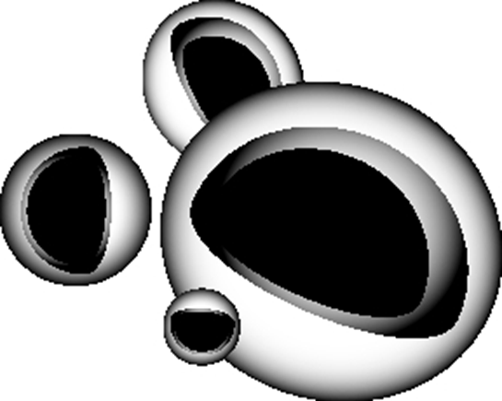
Structural Products
Light and Tough (LT) Compounds
Quickest and easiest light weighting solution!
Drop-in solution replacing glass filled compounds
10% weight savings without added cost or time of traditional lightweighting initiatives
+
Glass Fiber
Glass Bubbles

Slide 2
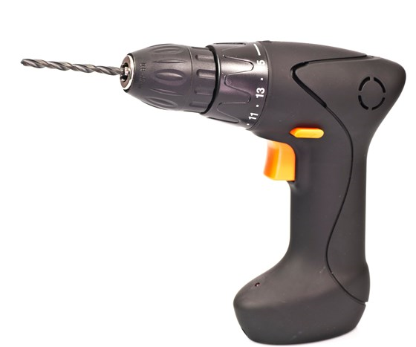
Structural products
LT Compounds: GF + Glass Bubble Hybrids
Products
20% - 50% Glass Filled Compounds
Nylon, PP, PE, PBT, PPA and PEEK
Availability
Americas, Europe, Asia
Application Examples
Fuel Savings: Automotive parts, recreational vehicles, drones, aircraft parts
Ergonomics: Backpacks, sports equipment, parts that are carried

Slide 3
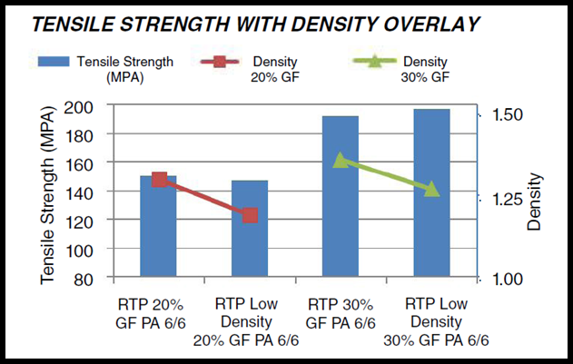
Structural products

Slide 4
Structural products
LT Compounds Technical Highlights
Drop-in solution for Glass Filled (GF) compounds with 8-10% reduction in density
Strength, stiffness and impact performance unchanged vs. GF
Does not effect color ability
Weight savings are independent of wall thickness or part geometry
Improved surface finish vs. foaming

