Slide 1
High Temperature Structural Products, Improved Performance at Elevated Temperatures and Harsh Environments
Matt Torosian,
Product Manager, High Temperature Structural Products

Slide 2
Presentation Overview
What are Ultra Performance products?
Highlights
Review of competing materials
Metals
Conventional engineering thermoplastics
VLF Products
Vs. Conventional reinforced TP compounds
Notes:
See next slide for comments…

Slide 3
Ultra Performance Structural
Dictionary: "Ultra” - Very or extreme. (descriptive)
Short Glass Fiber
PEEK
PPA
PPS
PEI
Short Carbon Fiber
Ultra Performance
Structural Compounds
Very Long Glass Fiber (VLF)

Slide 4
Ultra Performance Structural
Built upon RTP Company’s current standard product portfolio of industry-leading reinforced compounds by
Optimizing reinforcement technology
Optimizing process technology
Ultra Performance structural products are in addition to and do not replace our current high temperature structural products

Slide 5
Ultra Performance Highlights
10-30% higher strength and modulus in the RTP Company high temperature portfolio.
Greatest gains in CF compounds
PPA and PPS w/CF demonstrate a 30-40% improvement in room temperature physical properties.
40%CF PEEK with exceptional properties Vs. Victrex 90 HMF 40, the only other High Modulus PEEK available.
Targeted metal replacement in energy and D&A
VLF products have 3-4 times the impact of short glass products
Improved creep, fatigue and CLTE
5. Technology is transferable to other polymer
systems

Slide 6
Ultra Performance Structural Compounds for Greene Tweed, Houston TX

Slide 7
Ultra Performance Structural
Competitive metals
Die cast aluminum
Heat treated T-6 aluminum
Die cast zinc alloy (Zamak 3)

Slide 8
Competitive Materials
A-380 die cast aluminum and 6061 T-6 heat treated aluminum
A-380 accounts for over 85% of the Al die cast market
Pros
Excellent high temperature performance
Very good thermal conductivity
Very good EMI shielding capabilities
Good corrosion resistance
Light: good strength-to-weight ratio (specific strength)
Cons
Poor chemical resistance
Poor fatigue resistance
Subject to attack by galvanic corrosion when in contact with carbon fiber, carbon fiber composites, and other metals

Slide 9
Competitive Materials
ZAMAK alloys are widely used in die casting
Pros
Very good EMI shielding
Very good conductivity
Good strength
Cons
Poor creep resistance under load
Poor strength-to-weight ratio
Difficult to process vs. injection moldable plastics

Slide 10
ISO Tensile Strength
Heat Treated AL
Die Cast AL
ZAMAK 3
PEEK CF
PPA CF

Slide 11
Specific Tensile Strength
N·mm/kg
g/cc

Slide 12
What about Tg and Tm
Tg or glass transition temperature is critical when comparing materials for High Temp applications
Conventional semi-crystalline thermoplastics are usable above their Tg but physical properties begin to deteriorate quickly
Amorphous materials have defined Tg but have a more gradual drop off in properties bellow the Tg(see graph)
Creep and fatigue have increased effects above the TG of thermoplastic materials
Crystallinity is critical and affects the Tg
End use testing is the best measure of performance

Slide 13
Tensile Strength @ Temperature
°C
Notes:
Tg has a significant affect on high temperature performance. Note the significant drop in Tensile Strength at the Tg of Crystalline systems and the more gradual softening and decay in properties of the amorphous PEI.

Slide 14
Ultra Performance Structural Compounds vs. Competitive Thermoplastics

Slide 15
PPA 40%CF Relative Properties

Slide 16
Data Table of Ultra Performance PPA
Material | RTP 4087 | RTP 4087 UP | Comp. PPA 40% CF
Tensile Strength | 275 | 360 | 232 | MPa
Tensile Modulus | 32500 | 41500 | 35500 | MPa
Flexural Strength | 415 | 580 | 425 | MPa
Flexural Modulus | 27500 | 34500 | 26600 | MPa
Notched Izod Impact, | 7.0 | 9.0 | 7.0 | KJ/m²
Note: Properties tested using ISO test methods

Slide 17
PPS 40%CF Relative Properties

Slide 18
Data Table of Ultra Performance PPS
Material | RTP 1387 | RTP 1387 UP | Comp. PPS 40% CF
Tensile Strength | 215 | 260 | 207 | MPa
Tensile Modulus | 34000 | 40500 | 34500 | MPa
Flexural Strength | 295 | 405 | 209 | MPa
Flexural Modulus | 32500 | 32500 | 30000 | MPa
Notched Izod Impact, | 5.0 | 7.5 | 9.0* | KJ/m²
Note: Properties tested using ISO test methods
* Competitive material is a PPS alloy (no other 40% CF PPS competitive data available)

Slide 19
PEEK 40%CF Relative Properties

Slide 20
Data Table of Ultra Performance PEEK
Material | RTP 2287 HF | RTP 2287 UP | RTP 2299 X 133017 | Comp. PEEK 40% CF
Tensile Strength | 270 | 275 | 310 | 330 | MPa
Tensile Modulus | 27500 | 36000 | 46200 | 45000 | MPa
Flexural Strength | 385 | 415 | 480 | 480 | MPa
Flexural Modulus | 24000 | 31000 | 39300 | 37000 | MPa
Notched Izod Impact, | 6.5 | 6 | 10 | 11 | KJ/m²
Note: Properties tested using ISO test methods

Slide 21
An Introduction to VLF – Very Long Fiber Composites in High Temperature Materials

Slide 22
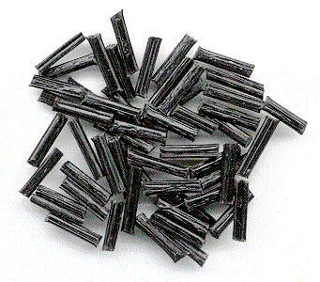
Typical Long Fiber Pellets

Slide 23
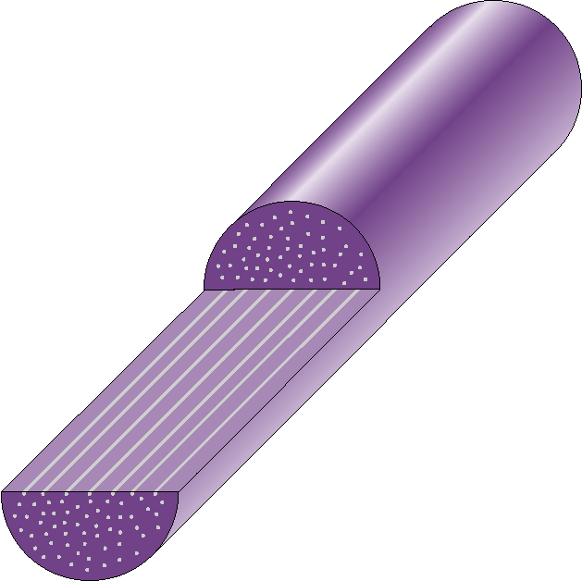
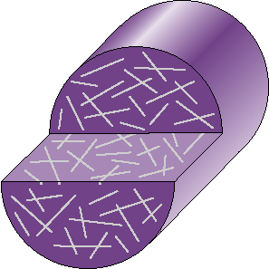
Short Fiber & VERY LONG FIBER
12 mm
3 mm
Fibers: ~2 mm 12 mm

Slide 24
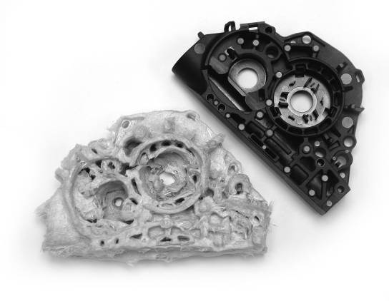
The Structural Skeleton
PA 66 + 60% VLF
Seat Belt Tensioner Housings

Slide 25
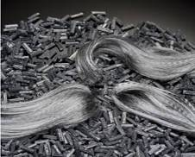
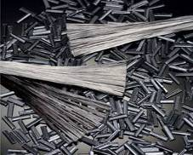
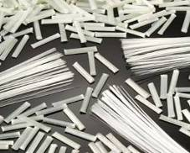
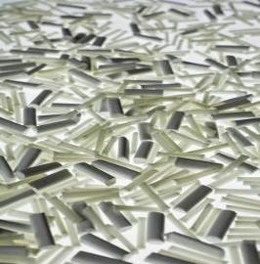
Masterbatch VLF Technologies
Steel
Carbon
Glass
Polymers
Additives
“Long Cut” technology
PEEK
PPS
PBT
TPU
PP
PA
Your color – Your way™
Flame retardants
Wear & lubricity
Heat stabilizers
Nano particles
UV resistance
Conductivity
Anti-stat

Slide 26
PEI 40%GF Relative Properties

Slide 27
PPS 50%GF Relative Properties

Slide 28
PPA 50%GF Relative Properties

Slide 29
PPA 50%GF Actual Properties
 | PPA 50% GF Competitive | VLF 84009 50% VLF GF | RTP 4009 50% GF | RTP 4009 UP 50% UP GF | Units
Tensile Strength | 270 | 275 | 250 | 285 | MPa
Tensile Modulus | 17000 | 18000 | 18000 | 20000 | MPa
Flex Strength | 390 | 400 | 370 | 440 | MPa
Flex Modulus | 17000 | 18000 | 17000 | 18500 | MPa
Notched Izod Impact, | 10 | 35 | 10 | 15 | KJ/m²
Note: Properties tested using ISO test methods

Slide 30
Questions?
Matt Torosian
mtorosian@rtpcompany.com
+1 317-663-4364

