Slide 1
Introduction
Duncan Hogg
Energy Market Manager

Slide 2
Profile
RTP Company is an independent, privately
. owned compounder
Global manufacturing and engineering support
Worldwide sales representation/distribution
Established in 1982
1000+ employees
$400+ million annual sales

Slide 3
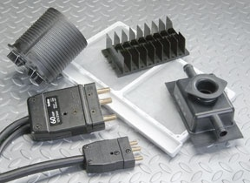
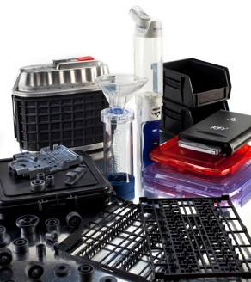
Custom Solutions
High-Tech to High Volume
60+ resins, 100’s of modifiers
Broadest range of competitive compounds
From talc polypropylene to nanotube PEEK
Annual Production
6000+ commercial products
1750+ new products each year

Slide 4
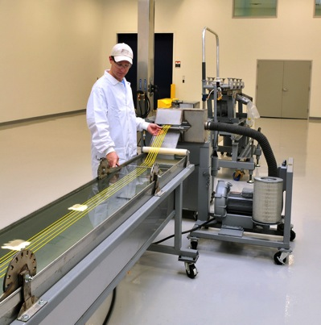
Our Goal
Satisfy Our Customers With:
Solutions
Technology
Flexibility
Speed

Slide 5
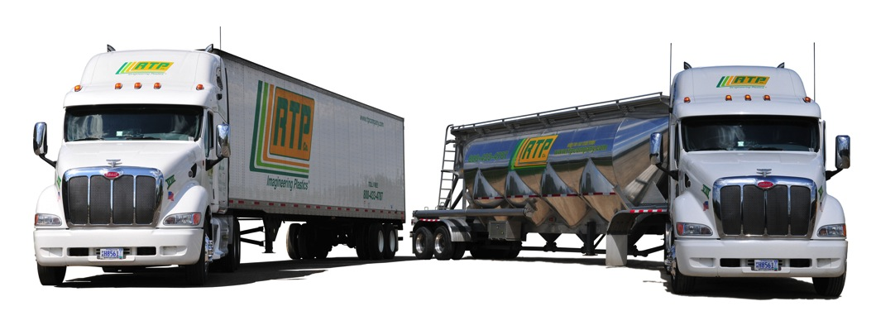
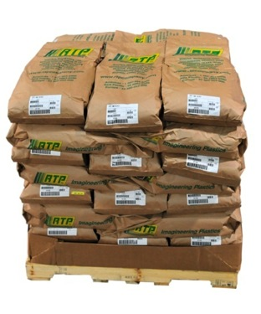
Flexibility To Meet YOUR Needs
Bags to Bulk
The Most Competitive Lead Times in the Industry
Notes:
SPEED !!!

Slide 6
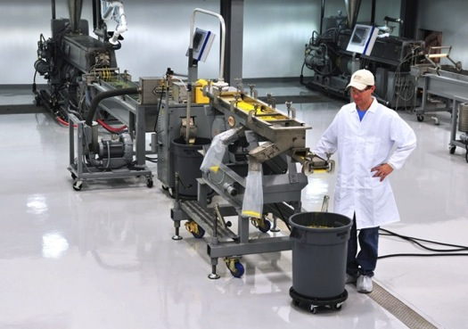
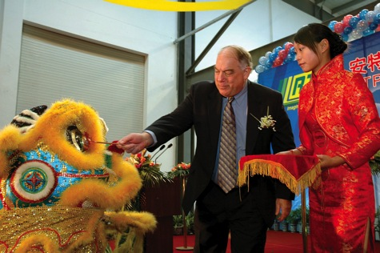
Our Culture
Entrepreneurial
“Bureaucracy-Less”
Delegate Authority

Slide 7
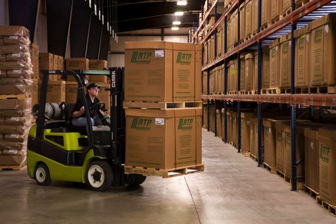
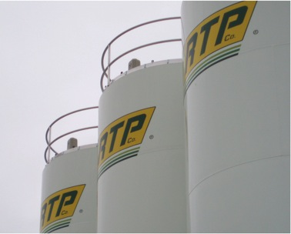
Independence
Objectivity In:
Raw Materials
Formulations
Solutions

Slide 8
Global Sales
80+ RTP Company Sales Engineers
Americas Canada, United States, Mexico, Brazil + distributors
Asia/Pacific China, Korea, Singapore, Japan, Taiwan, India + distributors
Europe Benelux, France, Germany, Italy, United Kingdom + distributors

Slide 9
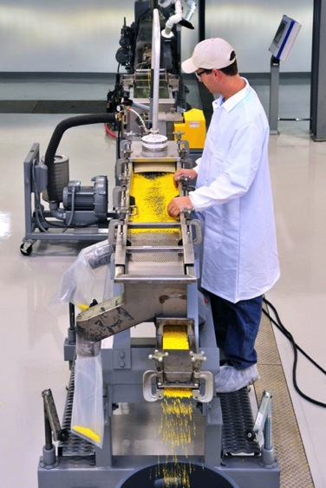
Product Development/R&D
40+ Product Development Engineers worldwide
Regional engineers for local support
Dedicated pilot plants in each region of the world
Product development
Process development
Customer trials and samples
Equipped for easy scale-up to production
Notes:
Composite and Chemical Engineers
Material Science Engineers
Chemists
PhDs
Regional Engineers in the US, Singapore China, France and Germany
Pilot plants in N. America, France, Singapore and China

Slide 10
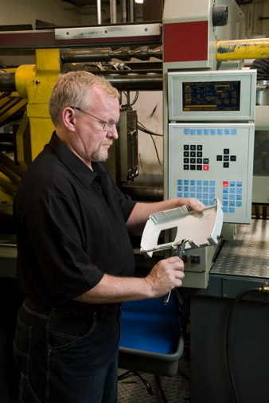
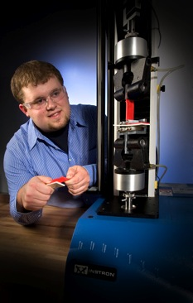
Technical Service
20+ Technical Service engineers and specialists worldwide:
Molding trials
Process optimization
Problem resolution
CAE support

Slide 11
Customer Service
Real people regionally located
20+ worldwide
Avg. 15+ years of experience
Dedicated to serving our customers

Slide 12
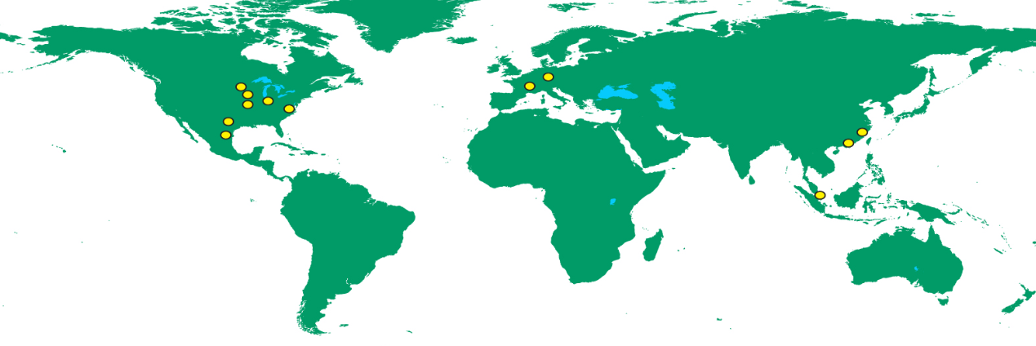
Your GLOBAL Compounder
OF CUSTOM ENGINEERED THERMOPLASTICS
Global Manufacturing
United States• Mexico • France • Germany • China • Singapore

Slide 13
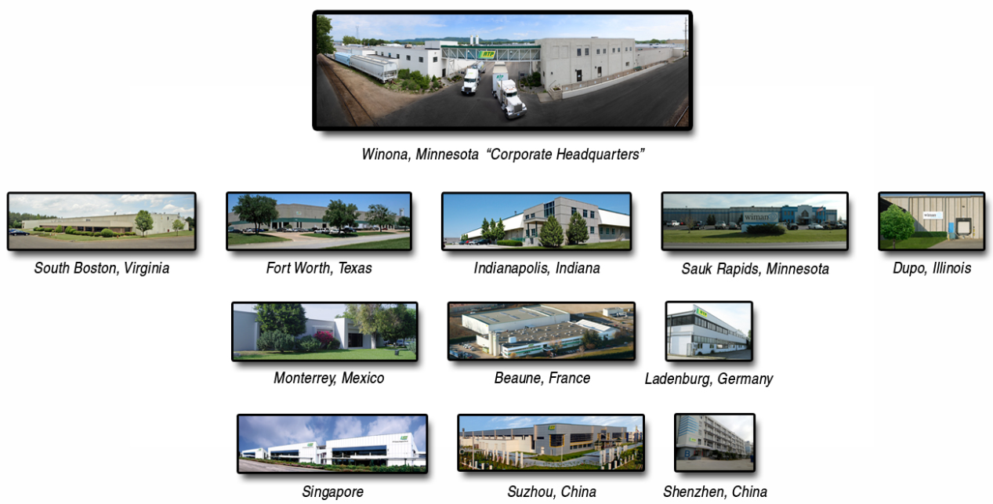
Your GLOBAL Compounder
OF CUSTOM ENGINEERED THERMOPLASTICS

Slide 14
Your GLOBAL Compounder
OF CUSTOM ENGINEERED THERMOPLASTICS
Develop it anywhere… make it anywhere…
support it everywhere!
Scalability: Develop your solution on a small scale and produce your solution in large quantities
Plant-to-plant consistency
ISO 9001:2008 Registered facilities

Slide 15
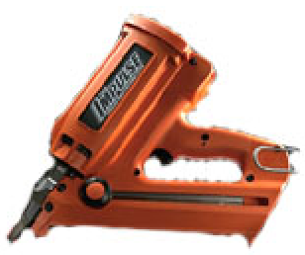
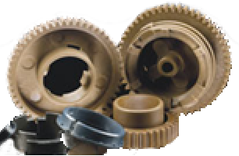
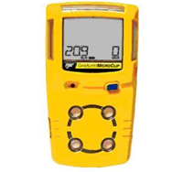
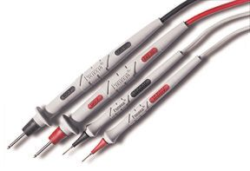
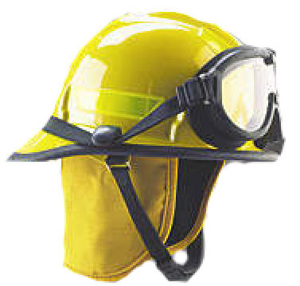
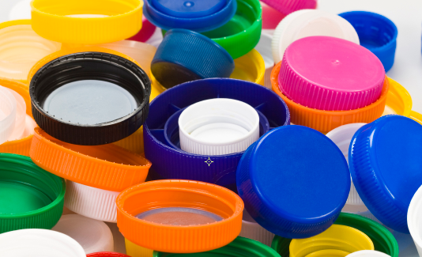
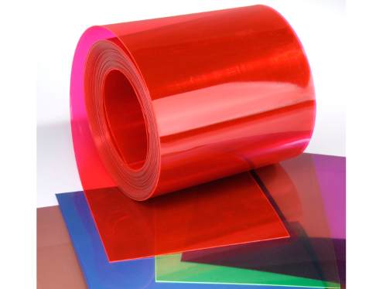
Product Families
COMPREHENSIVE PRODUCT LINE
STRUCTURAL
WEAR RESISTANT
CONDUCTIVE
THERMOPLASTIC
ELASTOMERS
FLAME RETARDANT
COLOR
FILM AND SHEET
Compounds formulated to meet your needs

Slide 16
YOUR GLOBAL COMPOUNDER OF CUSTOM ENGINEERED THERMOPLASTICS
Customer focused
Speed
“Bureaucracy-less”
Independent /objective
Global

Slide 17
Your Global Compounder of Custom Engineered Thermoplastics
http://www.rtpcompany.com

Slide 18
Questions?
Duncan Hogg
dhogg@rtpcompany.com
(507) 429-2262
Notes:
Any questions?

