Slide 1
Wear and Friction, Beyond the Fundamentals
Gregg Newby
Global Business Manager
Wear and Friction Technologies

Slide 2
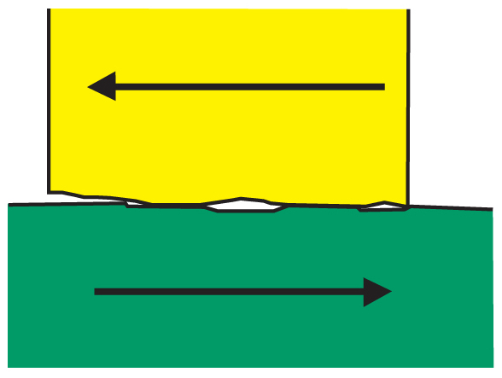
Definitions
Adhesive Wear Mechanism
The primary mechanism for thermoplastic wear
Characterized by transfer of material from one part to the other caused by frictional heat
Notes:
2

Slide 3
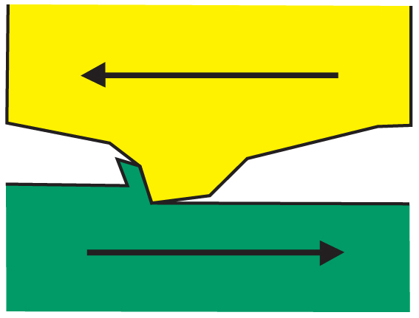
Definitions
Abrasive Wear Mechanism
Caused by a hard material scraping or abrading away at a softer material
Characterized by grooves cut or gouged into the surface
  Three Body

Slide 4
Testing Wear Resistance
Question: How do you simulate an application
and test a material for long-term
wear resistance?
Answer: Use ASTM D-3702 wear test to
quantify the amount of material a
sample loses over time under specific
conditions (pressure, speed,
temperature)

Slide 5
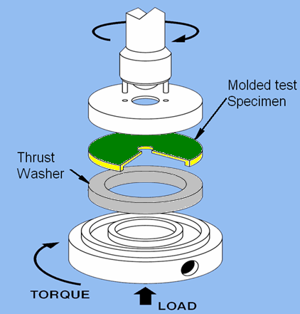
Wear Testing
ASTM D-3702 “Thrust Washer” Wear Test
Rotating
Molded or machined sample
Stationary
Thrust washer
(steel, aluminum, plastic, etc.)
Notes:
5

Slide 6
Wear Testing
ASTM D-3702 “Thrust Washer” Wear Test
Adjustable:
  Counter-surface (thrust washer)
  Pressure
  Velocity
  Temperature
The best use of this test is to perform comparative screening of multiple candidate materials
Notes:
6

Slide 7
Wear Factor (K)
K = W/(F x V x T)
K = Wear Factor: (in³-min/ft-lb-hr) ∙ 10⁻¹⁰ or (mm³/N-m) ∙ 10⁻⁸
W = Volume wear: in³ or mm³
F = Force: lb or N
V = Velocity: ft/min or m/sec
T = Elapsed time: hr or sec
100 Hour Test
Lower Value = Better Wear Resistance
Notes:
7

Slide 8
Definitions
Standard conditions
Steel thrust washer
40 psi : 50 ft/min (2000PV)
Ambient temp
100 hour test
PV = (Pressure · Velocity)
Conditions often used together
to characterize severity of a wear load
2,000 = (40 psi · 50 ft/min)
Notes:
PV is “pressure” x (times) “velocity”. We will use the acronym “PV” a lot, so if “pressure” and “velocity” don’t translate into something that starts with a “P” and a “V”, we will have to draw their attention to the English so they understand where it comes from.

Slide 9
Wear Testing
Wear data: typically shown at a specified PV
  Example: PV=2,000 (standard conditions)
    40 psi (P)
    50 ft./min(V)
Question: Does an equivalent PV always result in the same data?
  Let’s consider PV=2,000 (nonstandard conditions)
    10 psi (P)
    200 ft./min (V)

Slide 10
Wear Testing
Answer:
  No…Wear factor will change based on individual conditions.
  Generalizations may be helpful, but not always equivalent.
Notes:
By the “generalizations may be helpful” statement, we mean that one could say “POM + 20% PTFE performs well at this PV” (remember that PV is essentially a loading condition for our test). That may be true at certain combinations of load/pressure (P) and velocity (V) but perhaps not all combinations.

Slide 11
Wear Testing
Wear factor generally increases with higher PV
  (But not always!)
Wear per ASTM D 3702 against Steel

Slide 12
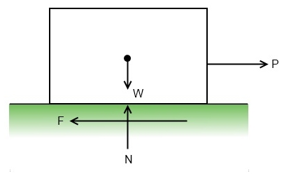
Definitions
Coefficient of Friction (µ)
Ratio of the force of friction between two bodies and the force pressing them together
µ=F/N
Notes:
No need to translate “need force diagram” as that is a note that I need to add a graphic on this page.

Slide 13

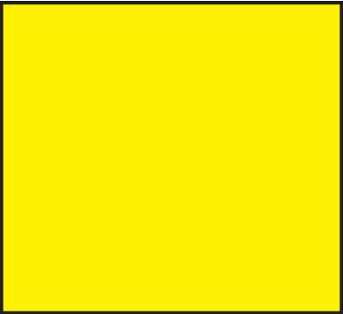
Types of Sliding Friction
Coefficient of Friction (µ)
    Static coefficient of friction (µ_{s}) = Fx/Fy
      Fx = Force to initiate motion
      Fy = Normal force holding surfaces together
    Dynamic coefficient of friction (µ_{k}) = Fx/Fy
      Fx = Force to sustain motion
      Fy = Normal force holding surfaces together

Slide 14
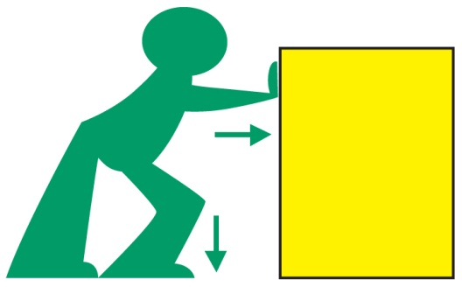
Friction and Thermoplastics
In most non-plastic materials
  µ_{k}<µ_{s}
Thermoplastics are somewhat unique
  µ_{k}>µ_{s}
May cause “slip/stick”
If µ_{k}>>µ_{s} you may have squeaking
Notes:
“slip/stick” is a term that essentially means that the part slips and starts moving, but then sticks because the forces can’t overcome the dynamic coefficient of friction, then it slips and starts moving, the sticks again.

Slide 15
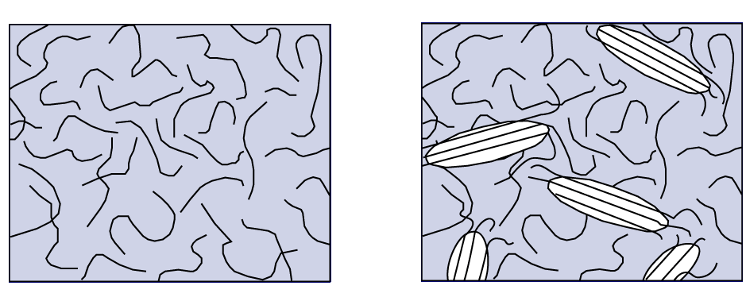
Morphology Characteristics
 | Amorphous | Semi-Crystalline
Low Shrinkage | X
Low Warpage | X
Tight Tolerances | X
Transparency | X
Mold Flow Ease |  | X
Chemical Resistance |  | X
Wear Resistance |  | X
Notes:
15

Slide 16
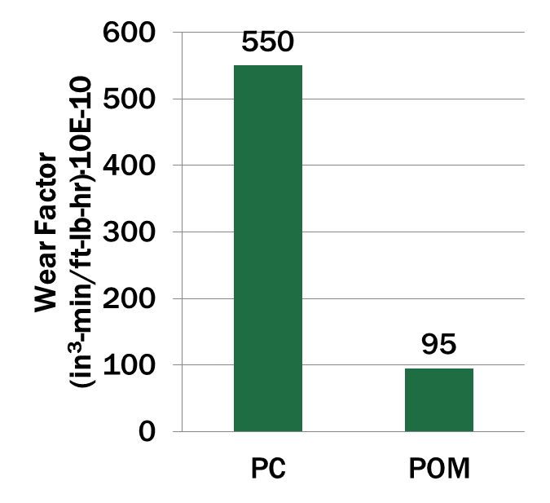
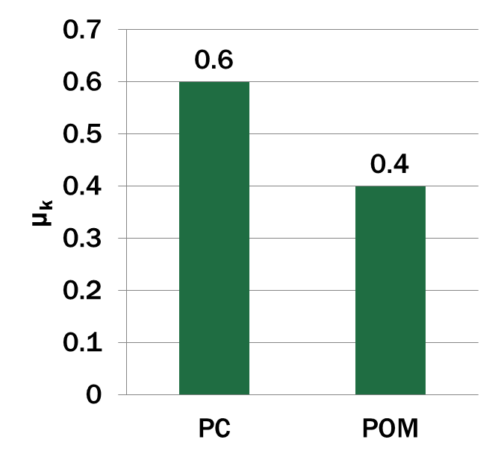
Morphology
Semi-crystalline polymers generally outperform amorphous materials in tribological tests
Wear and dynamic friction coefficient against Steel; PV = 2000

Slide 17
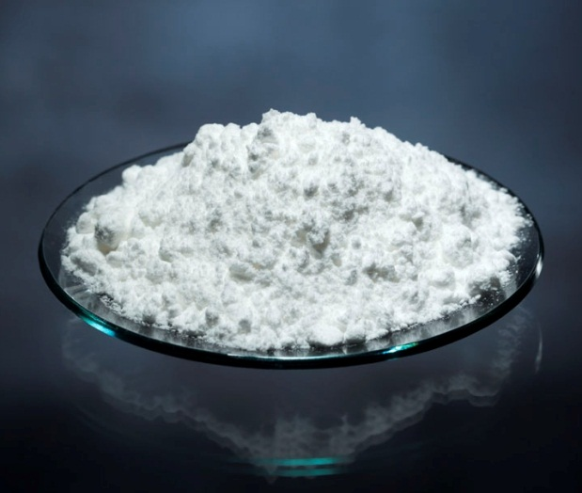
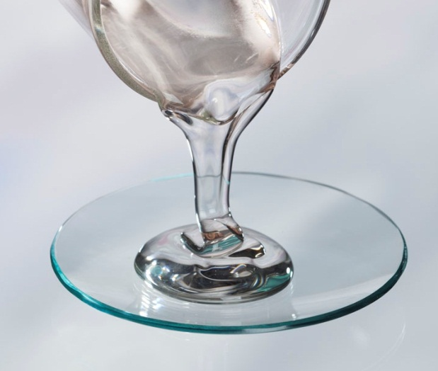
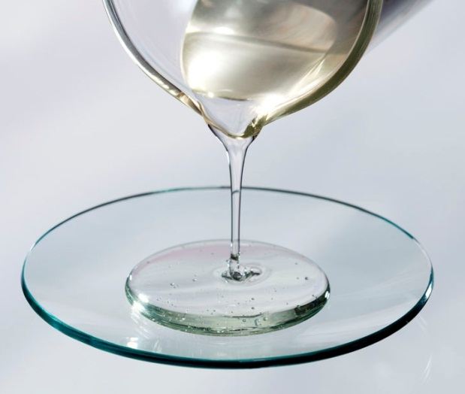
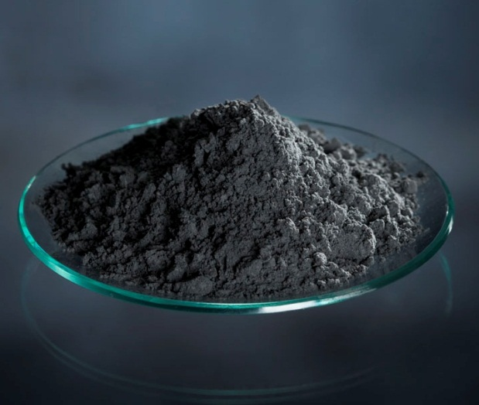
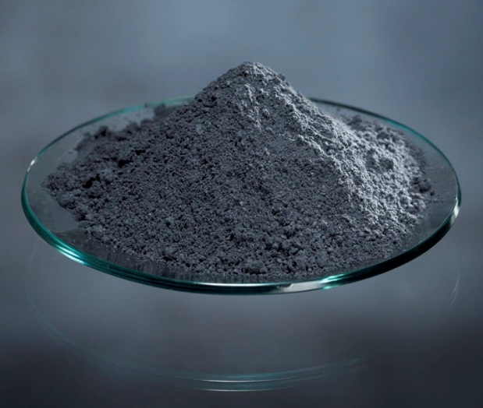
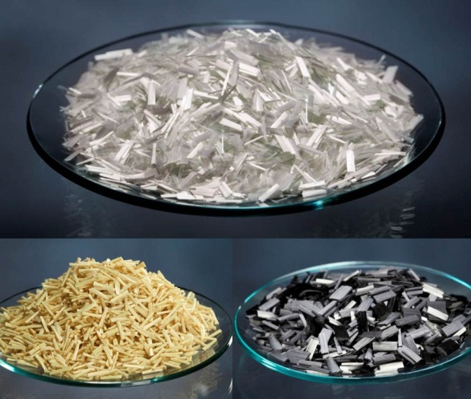
Additive Technologies
PTFE
Silicone
PFPE
Graphite Powder
MoS₂
Fibers

Slide 18
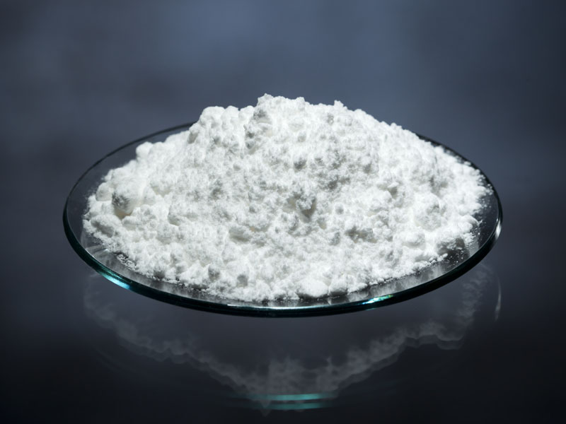
Additive Technologies
PTFE – Polytetrafluoroethylene (5-20%)
Workhorse additive – solid white powder
Homogeneously distributed throughout the polymer matrix
Forms a lubricious layer at polymer surface – requires a “Break-in” period
Compatible with nearly all thermoplastic resins
Limitations
Fluorine content
Die plate-out
Relatively high loadings
Becoming very expensive

Slide 19
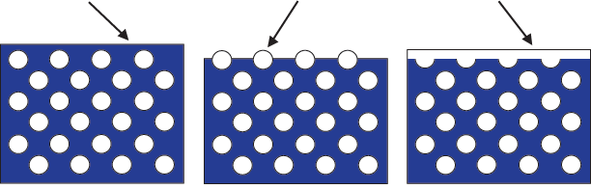
PTFE Wear Mechanism
Base Polymer Layer
Exposed PTFE
PTFE Layer
Part – As Molded
Part –After break-in period
Exposed PTFE shears form layer

Slide 20
PTFE Filled Compounds
Wear factor against Steel; PV = 2000

Slide 21
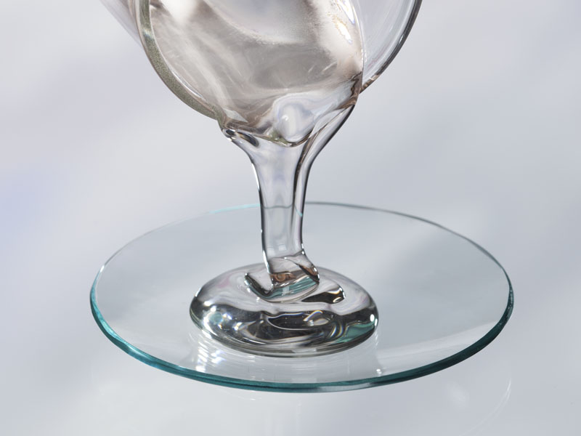
Additive Technologies
Silicone – Polydimethylsiloxane (1-3%)
Boundary lubricant which migrates to the surface over time
Migration rate is viscosity dependent
Excellent friction reducer
Best in high speed/low load applications
Used with PTFE to eliminate “Break-in” period
Limitations
Limited use in decorated parts
  Poor adhesion of paint or print inks
Bad for electrical applications
  Can foul contacts

Slide 22
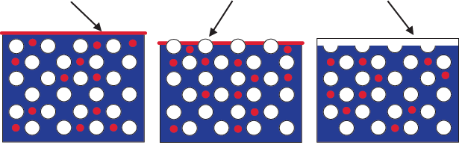
Additive Technologies
Sl Present as Molded
Exposed PTFE
Sl + PTFE Layer
Part – As Molded
Part – After break-in period

Slide 23
Wear Resistance Data
Wear per ASTM D 3702 against Steel; PV = 2000

Slide 24
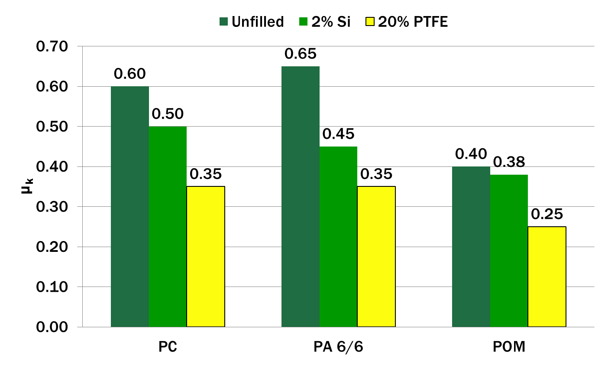
Friction Data
Dynamic friction coefficient per ASTM D 3702 against Steel; PV = 2000

Slide 25
Physical Property Comparison
 | PC |  |  | PA 6/6 |  |  | POM
 | Unfilled | PTFE (20%) | Silicone (2%) | Unfilled | PTFE (20%) | Silicone (2%) | Unfilled | PTFE (20%) | Silicone (2%)
Specific Gravity | 1.19 | 1.31 | 1.19 | 1.14 | 1.26 | 1.13 | 1.41 | 1.52 | 1.40
Tensile Strength (psi) | 8,500 | 7,000 | 8,500 | 12,000 | 9,500 | 11,000 | 8,700 | 6,500 | 7,800
Flexural Modulus (psi) | 340,000 | 320,000 | 350,000 | 400,000 | 400,000 | 400,000 | 350,000 | 300,000 | 350,000
Notched Impact (ft-lb/in) | 7.5 | 3.5 | 10.5 | 1.0 | 1.0 | 1.0 | 1.5 | 1.0 | 1.5
Values per ASTM test methods

Slide 26
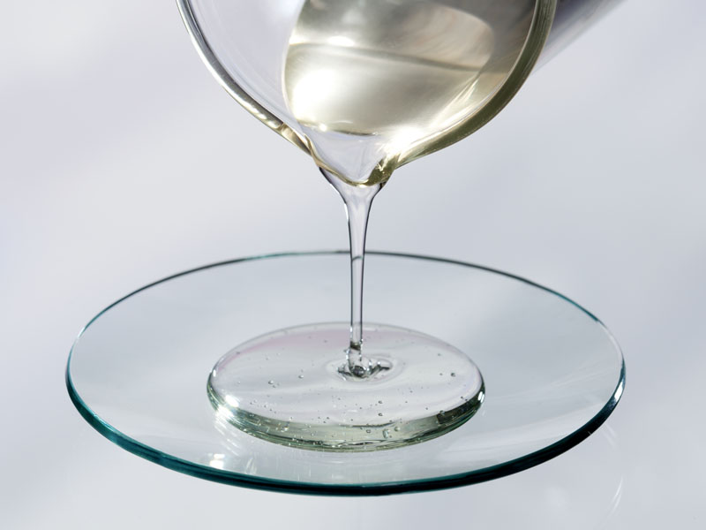
Additive Technologies
PFPE – Perfluoropolyether Oil (< 1%)
Thermally stable up to PEEK processing temps
Differentiates RTP Company from others
Physical properties maintained
Minimized die plate-out
Synergy with PTFE
Specific gravity benefits
Improved fatigue resistance
Limitations
Limited effectiveness in amorphous resins
Needs PTFE “kick” to deliver optimum friction reduction

Slide 27
Polymers and Additives
PFPE allows for a reduction in PTFE loadings
Wear per ASTM D 3702 against Steel, PV = 2000

Slide 28
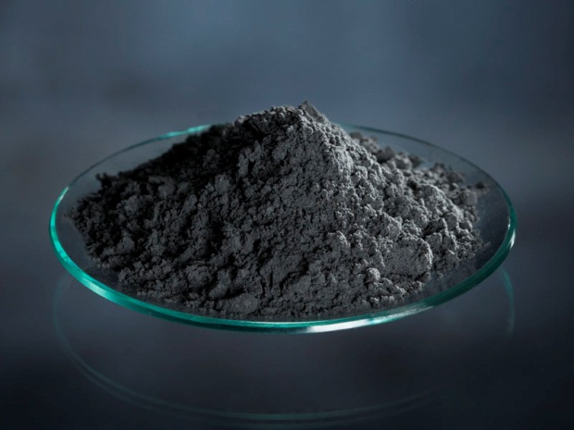
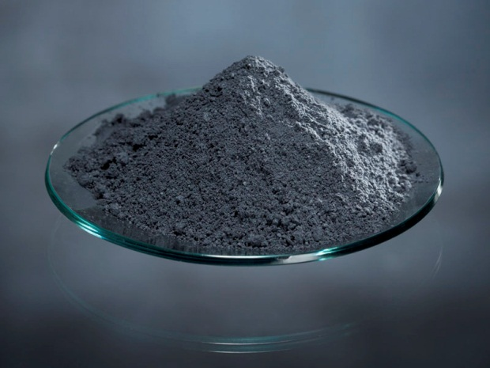
Additive Technologies
Graphite Powder (5-30%)
Aqueous environments
Excellent temperature resistance
Black color
Molybdenum Disulfide - MoS₂ (1-5%)
Nucleating agent in nylons: creates harder surface
High affinity to metal:
  Smoother mating metal surface = lower wear
Limitations
Limited use
Dark color limits colorability
Sloughing type additives

Slide 29
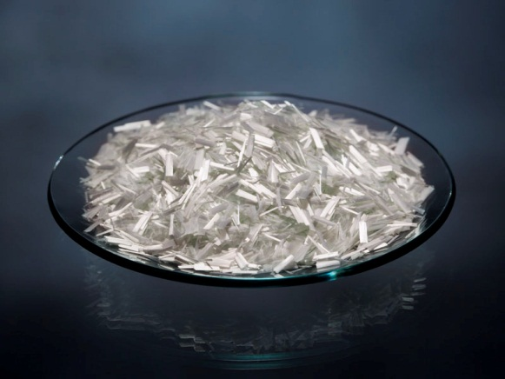
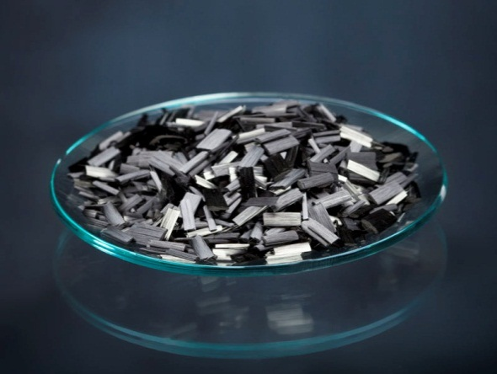
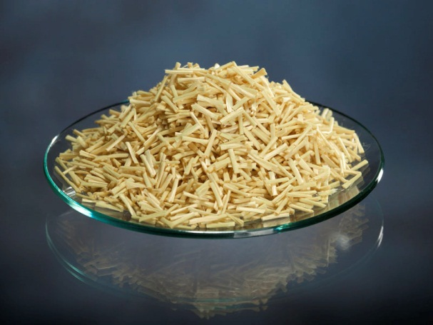
Fibers and Wear Resistance
Reinforcing Fibers
Glass Fiber
Carbon Fiber
Aramid Fiber
Improved bearing capabilities/wear resistance
Very abrasive
Higher bearing capabilities
Excellent thermal resistance
Conductive
Less abrasive
Little strength improvement
Very gentle to mating surface

Slide 30
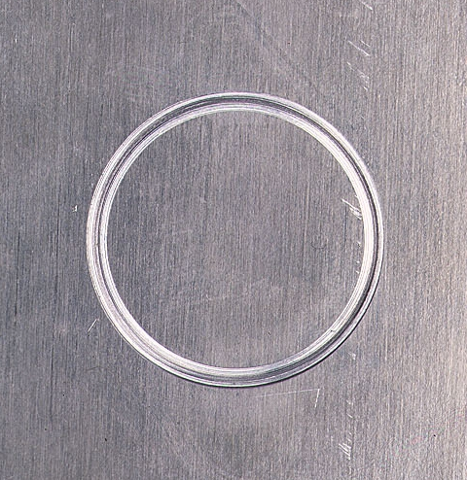
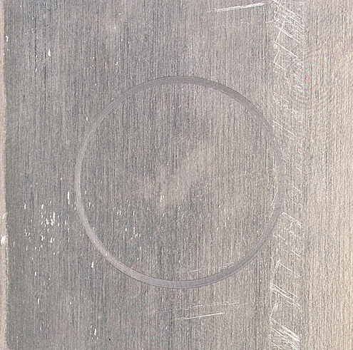
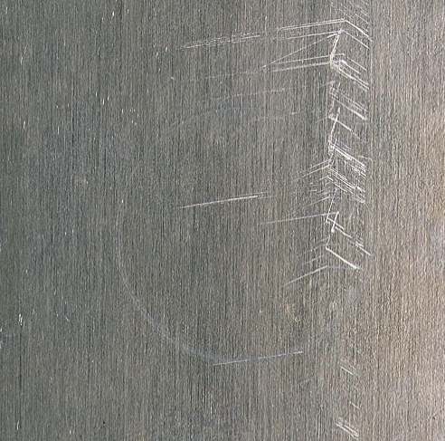
Fibers and Wear Resistance
Fibers protect the polymer, but may be abrasive against the mating material
Glass
Carbon
Aramid
Aluminum Contact Surface

Slide 31
RTP Company
Ultra Wear & Friction Compounds
Notes:
Good Morning everyone. My name is Gregg Newby. Thank you for joining this training webinar today. Our objective is to inform and support you in a better understanding of how you can take the fullest advantage of RTP’s unique Ultra Wear & Friction technologies.

Slide 32
What is Ultra Wear & Friction?
RTP has developed a family of Ultra Wear & Friction (W&F) Compounds that have been tested and proven to support applications requiring
  Excellent wear performance at very high loads
  Excellent friction performance at very high speeds

Slide 33
What is Ultra Wear & Friction?
In addition to high load and high speed performance, Ultra W&F Compounds also exhibit
  Resistance to a broad range of chemicals
  Resistance to high temperatures
  Improved thermal conductivity
  Excellent long term creep and fatigue properties
Notes:
As you can see Ultra W&F cpds operate in the most demanding environments.

Slide 34
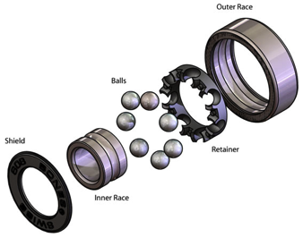
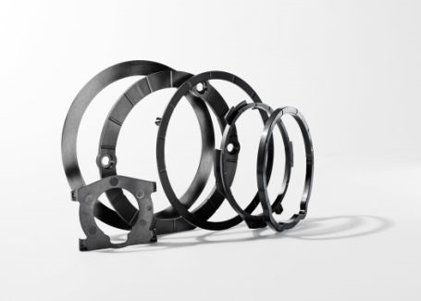
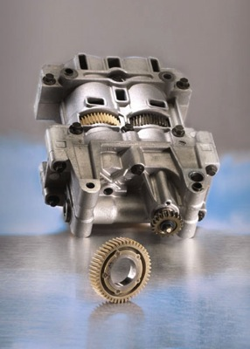
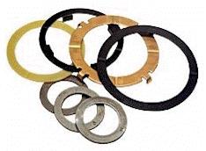
Broad Application
Bearings and Bushings
Seals and Rings
Gears
Thrust Washers
Notes:
Ultra Wear has a fit within a broad set of applications both market and geographical. Feature here are the 4 main categories.

Slide 35
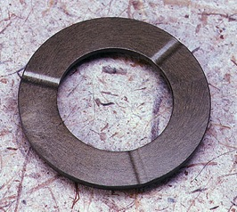
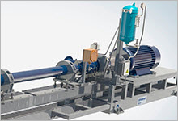
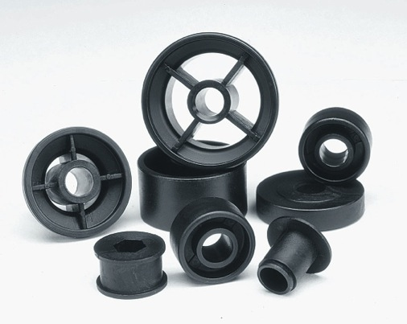
Broad Markets
Automotive
Transmissions
Braking
Steering
Pulleys
Energy
Down Hole,
Chemical
Processing
Equipment
Industrial
Pumps
Conveyors
Notes:
Similar to Applications the Markets are also broad providing new targets to hundreds of OEM’s many of which RTP does not work with today. Examples would be…..

Slide 36
Wear Testing Conditions
Typical Test Conditions
    2000 PV: 40 psi ∙ 50 ft/min
    2000 PV: 10 psi ∙ 200 ft/min
    5000 PV: 50 psi ∙ 100 ft/min
    10,000 PV: 200 psi ∙ 50 ft/min
    10,000 PV: 50 psi ∙ 200 ft/min
Ultra Testing
  10,000 PV
  25,000 PV
  50,000 PV
  75,000 PV (+400F)
  100,000 PV (+400F)

Slide 37
Fifteen “Ultra” Compounds
Polymer | Description | Grade
PPS | PPS-AF/TFE | RTP 1300 AR 15 TFE 15
PPS | PPS-GF/TFE | RTP 1305 TFE 15
PPS | PPS-CF/TFE | RTP 1385 TFE 15
PPS | PPS-CF/Proprietary Wear | RTP 1399 X 91160
PEEK | PEEK-AF/TFE | RTP 2200 AR 15 TFE 15
PEEK | PEEK-CF/TFE | RTP 2285 HF TFE 15
PEEK | PEEK-CF/GRPH/TFE | RTP 2299 X 81382
PEEK | PEEK-CF/GRPH/TFE/PFPE | RTP 2299 X 113763 B
PEEK | PEEK-CF/CF/AF/TFE | RTP 2299 X 113783 A
PEEK | PEEK-CF/PFPE | RTP 2299 X 120337
PEEK | PEEK-CF/GRPH/TFE (CGP) | RTP 2299 X 125106
PEEK | PEEK-CF/Ceramic | RTP 2299 X 125404 A
PPA | PPA-CF/TFE | RTP 4085 TFE 15
PPA | PPA-CF/Proprietary Wear | RTP 4099 X 105534
PPA | PPA-CF/AF/TFE/SI | RTP 4099 X 123510 A
Please note the inclusion of RTP CGP technology

Slide 38
Non-RTP Compounds
Compound | Polymer | Additive | Registered Trademark of
Rulon® J | PTFE (High Mol Wt) | Proprietary | St. Gobain Performance Plastics
Rulon® LR | PTFE (High Mol Wt) | Proprietary | St. Gobain Performance Plastics
Torlon® 4301 | PAI (Pseudo TS) | PTFE, Graphite | Solvay Specialty Polymers
Torlon® 4630 | PAI (Pseudo TS) | PTFE, Graphite | Solvay Specialty Polymers
Vespel® SP-21 | TS PI (TS) | Graphite | E.I. du Pont de Nemours
Vespel® SP-211 | TS PI (TS) | PTFE, Graphite | E.I. du Pont de Nemours
Stanyl® TW371 | PA 4/6 (TP) | PTFE | DSM Engineering Plastics

Slide 39
10,000 PV : 100 psi @ 100 ft/min
Not Melt Processable
Extensive Post Curing Process
Melt Processable Thermoplastic
Compound | Wear Factor (in³-min/ft-lb-hr)*E-10 | Dynamic µ
PTFE 1 | 3 | 0.23
PTFE 2 | 11 | 0.22
TS-PI 1 | 18 | 0.38
PAI 1 | 21 | 0.34
PPS-CF/Proprietary Wear | 23 | 0.57
PPA-CF/AF/TFE/SI | 31 | 0.41
PPS-AF/TFE | 33 | 0.19
TS-PI 2 | 34 | 0.32
PEEK-CF/GRPH/TFE/PFPE | 42 | 0.73
PAI 2 | 46 | 0.39
PA 4/6-TFE | 59 | 0.19
Compound | Wear Factor (in³-min/ft-lb-hr)*E-10 | Dynamic µ
PEEK-CF/GRPH/TFE | 63 | 0.28
PPA-CF/TFE | 65 | 0.79
PEEK-CF/GRPH/TFE (CGP) | 79 | 0.50
PEEK-CF/PFPE | 81 | 0.59
PEEK-CF/AF/TFE | 86 | 0.12
PEEK-CF/TFE | 124 | 0.18
PEEK-AF/TFE | 158 | 0.28
PPS-GF/TFE | 233 | 0.55
PPS-CF/TFE | 296 | 0.36
PEEK-CF/Ceramic | 305 | 0.28
PPA-CF/Proprietary Wear | 536 | 0.35

Slide 40
10,000 PV : 50 psi @ 200 ft/min
Not Melt Processable
Extensive Post Curing Process
Melt Processable Thermoplastic
Compound | Wear Factor (in³-min/ft-lb-hr)*E-10 | Dynamic µ
PTFE 2 | 9 | 0.23
PTFE 1 | 11 | 0.23
PA 4/6-TFE | 14 | 0.32
PEEK-CF/AF/TFE | 18 | 0.61
PPS-AF/TFE | 19 | 0.16
TS-PI 1 | 23 | 0.37
PEEK-CF/GRPH/TFE | 25 | 0.23
PPA-CF/AF/TFE/SI | 39 | 0.47
PPA-CF/TFE | 43 | 0.65
PEEK-CF/GRPH/TFE/PFPE | 49 | 0.71
PAI 2 | 51 | 0.27
Compound | Wear Factor (in³-min/ft-lb-hr)*E-10 | Dynamic µ
PEEK-CF/PFPE | 54 | 0.40
TS-PI 2 | 69 | 0.49
PAI 1 | 70 | 0.24
PEEK-CF/TFE | 97 | 0.21
PPS-CF/Proprietary Wear | 139 | 0.65
PEEK-AF/TFE | 146 | 0.25
PEEK-CF/GRPH/TFE (CGP) | 152 | 0.55
PEEK-CF/Ceramic | 220 | 0.24
PPS-GF/TFE | 247 | 0.53
PPS-CF/TFE | 459 | 0.49
PPA-CF/Proprietary Wear | 1008 | 0.18

Slide 41
50,000 PV : 500 psi @ 100 ft/min
Not Melt Processable
Extensive Post Curing Process
Melt Processable Thermoplastic
Compound | Wear Factor (in³-min/ft-lb-hr)*E-10 | Dynamic µ
PTFE 1 | 4 | 0.15
PTFE 2 | 18 | 0.16
PAI 1 | 24 | 0.12
PEEK-CF/Ceramic | 29 | 0.06
TS-PI 1 | 43 | 0.14
TS-PI 2 | 58 | 0.15
PPS-CF/Proprietary Wear | 78 | 0.24
PEEK-CF/GRPH/TFE | 79 | 0.16
PAI 2 | 105 | 0.18
PEEK-AF/TFE | 119 | 0.18
PEEK-CF/GRPH/TFE (CGP) | 133 | 0.23
Compound | Wear Factor (in³-min/ft-lb-hr)*E-10 | Dynamic µ
PPS-CF/TFE | 134 | 0.26
PPS-AF/TFE | Wear Limit | NA
PPS-GF/TFE | Wear Limit | NA
PEEK-CF/TFE | Wear Limit | NA
PEEK-CF/GRPH/TFE/PFPE | Wear Limit | NA
PEEK-CF/AF/TFE | Wear Limit | NA
PEEK-CF/PFPE | Wear Limit | NA
PPA-CF/TFE | Wear Limit | NA
PPA-CF/Proprietary Wear | Wear Limit | NA
PPA-CF/AF/TFE/SI | Wear Limit | NA
PA 46 - TFE | Wear Limit | NA

Slide 42
50,000 PV : 250 psi @ 200 ft/min
Not Melt Processable
Extensive Post Curing Process
Melt Processable Thermoplastic
Compound | Wear Factor (in³-min/ft-lb-hr)*E-10 | Dynamic µ
PTFE 1 | 8 | 0.21
PTFE 2 | 9 | 0.25
PEEK-CF/Ceramic | 27 | 0.07
PAI 1 | 37 | 0.12
TS-PI 2 | 38 | 0.11
TS-PI 1 | 42 | 0.13
PEEK-AF/TFE | 45 | 0.15
PEEK-CF/GRPH/TFE | 94 | 0.18
PPS-CF/Proprietary Wear | 96 | 0.19
PPS-CF/TFE | 127 | 0.19
PEEK-CF/GRPH/TFE (CGP) | 194 | 0.23
Compound | Wear Factor (in³-min/ft-lb-hr)*E-10 | Dynamic µ
PEEK-CF/PFPE | 202 | 0.24
PAI 2 | 262 | 0.23
PEEK-CF/AF/TFE | 337 | 0.26
PPS-AF/TFE | Wear Limit | NA
PPS-GF/TFE | Wear Limit | NA
PEEK-CF/TFE | Wear Limit | NA
PEEK-CF/GRPH/TFE/PFPE | Wear Limit | NA
PPA-CF/TFE | Wear Limit | NA
PPA-CF/Proprietary Wear | Wear Limit | NA
PPA-CF/AF/TFE/SI | Wear Limit | NA
PA 46 - TFE | Wear Limit | NA

Slide 43
Elevated Temperature
400°F /205°C
Test Results

Slide 44
Elevated Temperature Testing
Tested at 200 ft/min (1.01 m/s)
  10,000 PV: 50 psi (350 PV: 2.25 N)
  50,000 PV: 250 psi (1750 PV: 11.24 N)
  75,000 PV: 375 psi (2625 PV: 16.86 N)
  100,000 PV: 500 psi (3500 PV: 22.48 N)

Slide 45
10,000 PV : 100 psi @ 100 ft/min
Not Melt Processable
Extensive Post Curing Process
Melt Processable Thermoplastic
Compound | Wear Factor (in³-min/ft-lb-hr)*E-10 | Dynamic µ
PTFE 1 | 3 | 0.23
PTFE 2 | 11 | 0.22
TS-PI 1 | 18 | 0.38
PAI 1 | 21 | 0.34
PPS-CF/Proprietary Wear | 23 | 0.57
PPA-CF/AF/TFE/SI | 31 | 0.41
PPS-AF/TFE | 33 | 0.19
TS-PI 2 | 34 | 0.32
PEEK-CF/GRPH/TFE/PFPE | 42 | 0.73
PAI 2 | 46 | 0.39
PA 4/6-TFE | 59 | 0.19
Compound | Wear Factor (in³-min/ft-lb-hr)*E-10 | Dynamic µ
PEEK-CF/GRPH/TFE | 63 | 0.28
PPA-CF/TFE | 65 | 0.79
PEEK-CF/GRPH/TFE (CGP) | 79 | 0.50
PEEK-CF/PFPE | 81 | 0.59
PEEK-CF/AF/TFE | 86 | 0.12
PEEK-CF/TFE | 124 | 0.18
PEEK-AF/TFE | 158 | 0.28
PPS-GF/TFE | 233 | 0.55
PPS-CF/TFE | 296 | 0.36
PEEK-CF/Ceramic | 305 | 0.28
PPA-CF/Proprietary Wear | 536 | 0.35

Slide 46
400°F (205°C) Testing 10,000 PV : 100 psi @ 200 ft/min
Not Melt Processable
Extensive Post Curing Process
Melt Processable Thermoplastic
Disc Material | Wear Factor (in³-min/ft-lb-hr)*E-10 | Dynamic µ
PTFE 1 | 14 | 0.23
PTFE 2 | 28 | 0.25
PEEK-CF/Ceramic | 77 | 0.03
PEEK-CF/GRPH/TFE | 116 | 0.35
TS-PI 1 | 120 | 0.13
PPS-CF/Proprietary Wear | 126 | 0.55
TS-PI 2 | 127 | 0.09
PAI 1 | 155 | 0.10
PAI 2 | 206 | 0.28
PEEK-CF/TFE | 219 | 0.89

Slide 47
400°F (205°C) Testing 50,000 PV : 250 psi @ 200 ft/min
Not Melt Processable
Extensive Post Curing Process
Melt Processable Thermoplastic
Disc Material | Wear Factor (in³-min/ft-lb-hr)*E-10 | Dynamic µ
PTFE 1 | 6 | 0.22
PAI 1 | 42 | 0.16
PEEK-CF/Ceramic | 43 | 0.05
TS-PI 2 | 52 | 0.08
TS-PI 1 | 58 | 0.10
PPS-CF/Proprietary Wear | 76 | 0.50
PAI 2 | 116 | 0.20
PEEK-CF/GRPH/TFE | 170 | 0.22
PEEK-CF/TFE | Wear Limit | NA
PTFE 2 | Wear Limit | NA

Slide 48
400°F (205°C) Testing 75,000 PV : 500 psi @ 150 ft/min
Not Melt Processable
Melt Processable Thermoplastic
Disc Material | Wear Factor (in³-min/ft-lb-hr)*E-10 | Dynamic µ
PEEK-CF/Ceramic | 33 | 0.06
TS-PI 2 | 35 | 0.07
TS-PI 1 | 54 | 0.10
PEEK-CF/GRPH/TFE | Wear Limit | NA
PPS-CF/Proprietary Wear | Wear Limit | NA
PEEK-CF/TFE | Wear Limit | NA
PTFE 1 | Wear Limit | NA
PTFE 2 | Wear Limit | NA
PAI 1 | Wear Limit | NA
PAI 2 | Wear Limit | NA

Slide 49
400°F (205°C) Testing 100,000 PV : 500 psi @ 200 ft/min
Not Melt Processable
Melt Processable Thermoplastic
Disc Material | Wear Factor (in³-min/ft-lb-hr)*E-10 | Dynamic µ
PEEK-CF/Ceramic | 23 | 0.05
TS-PI 1 | 40 | 0.10
TS-PI 2 | 42 | 0.07
PEEK-CF/GRPH/TFE | Wear Limit | NA
PPS-CF/Proprietary Wear | Wear Limit | NA
PEEK-CF/TFE | Wear Limit | NA
PTFE 1 | Wear Limit | NA
PTFE 2 | Wear Limit | NA
PAI 1 | Wear Limit | NA
PAI 2 | Wear Limit | NA

Slide 50
What’s Next?
Identify compounds optimized for resistance to wear in extremely abrasive environments
  Work with an outside laboratory to develop a series of abrasive tests to identify best performing compounds
Notes:
50

Slide 51
Planned Abrasion Testing Project
Two Test Methods for Initial Screening:
ASTM G75 (Miller Abrasion)
ASTM G105 dry abrasive with and without slurry adaptor
Abrasives to be used:
  AL₂O₃ for “down-hole”/energy applications
  AFS 50-70 test sand for automotive/industrial applications

Slide 52
Questions?
Gregg Newby
gnewby@rtpcompany.com
(843) 425-7633

Slide 53
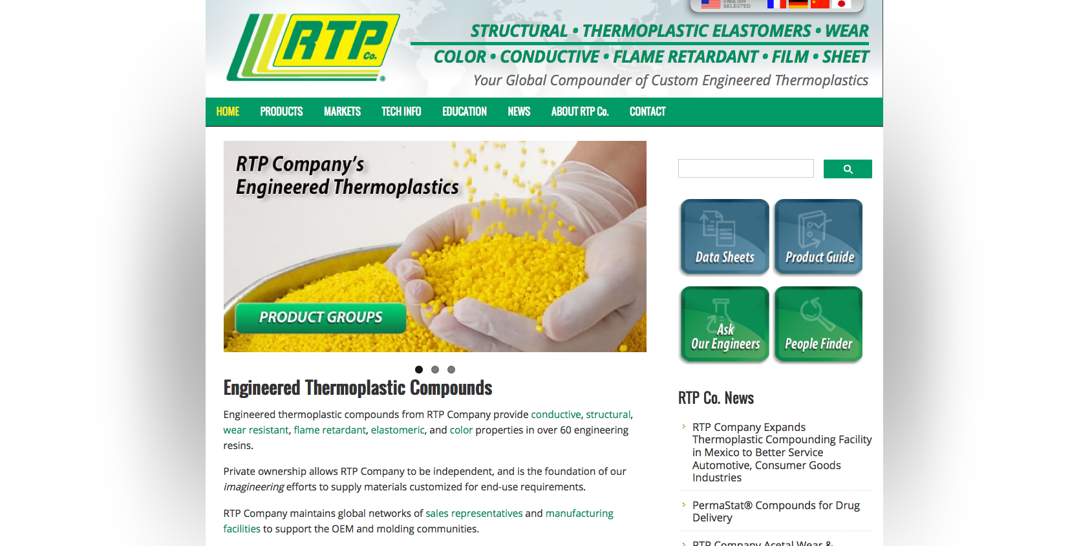
RTP Company
Visit www.rtpcompany.com to learn more about RTP Company’s complete portfolio of custom engineered thermoplastic compounds

