Slide 1
An Engineer’s Guide to Specifying the Right Thermoplastic
Jason Becker
Application Development Engineer

Slide 2
Independent Specialty Compounder
Compounder→ We blend thermoplastic resins with fillers, additives, and modifiers
Specialty → We create engineered formulations
Independent → We are unbiased in our selection of raw materials
Notes:
Emphasize that RTP is independent (not owned by a plastics company), specialty (non-commodity), compounder

Slide 3
Agenda
Define Compounding
Plastic Resin Selection Process
Application Case Studies
Compounding Performance
Engineered Thermoplastic Compounds
Notes:
Today’s agenda will include…

Slide 4
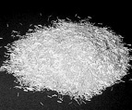
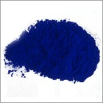
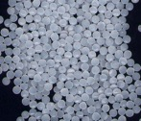
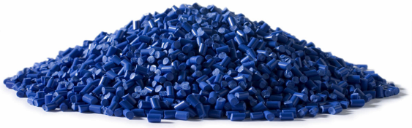
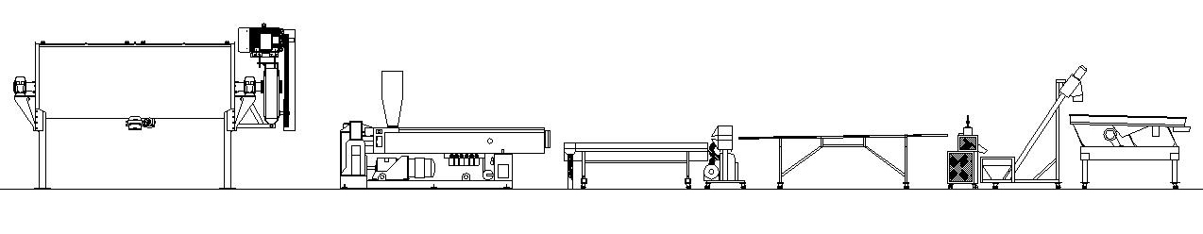
Compounding Process
Raw Materials
Finished Product
Blender
Cooling
Classifier
Extruder
Pelletizer
Notes:
A simplified depiction of the compounding process and equipment used to convert raw materials to finished product. Note RTP finished product is typically in the pellet form.

Slide 5
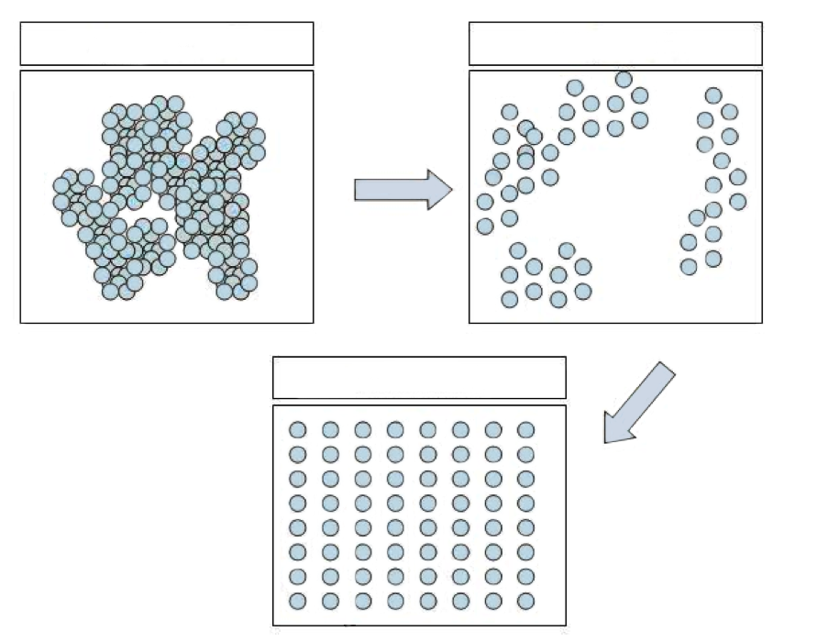
Compounding Objectives
Mixing
  Distributive
  Dispersive
  Agglomerates
  Dispersion
  Distribution
Notes:
The objectives of our compounding process is to achieve both distributive (good distribution) and dispersive (broken into smallest particles) mixing.

Slide 6
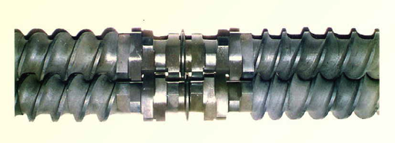
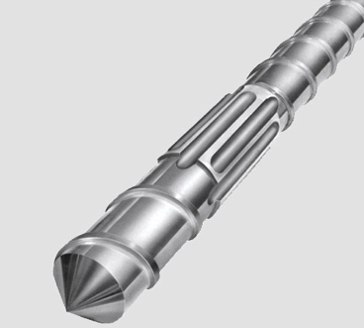
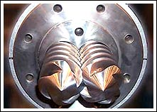
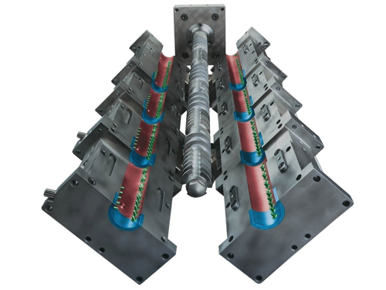
Compounding Extruders
Single Screw
Twin Screw
Co-Kneader
Notes:
RTP uses 3 types of extruders to meet our compounding objectives. All can achieve high distributive mixing. The Twin Screw & Co-Kneader have best dispersive mixing capabilities for fine powders.

Slide 7
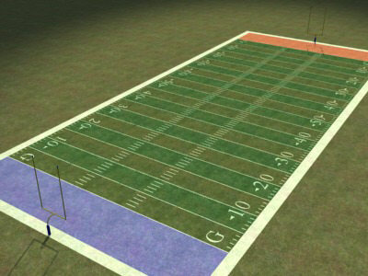
Putting Compounding Into Perspective
Conductive carbon black surface area = 130 m²/gram
34 grams carbon black = surface area of football field (4460m²)
Dispersing a 20% carbon black compound is similar to evenly coating a football field with 136 grams of plastic!
Notes:
The compounding extruders do a considerable amount of work. Many of the additives have extremely high amounts of surface area which must be completely wet-out (coated) by the plastic resin. For instance to disperse 20% carbon black into a plastics is similar to coating the surface of a football field with only 136 grams of plastic!

Slide 8
Resin Selection
Notes:
Next we discuss the methodology the RTP uses to select the proper resin for the compound.

Slide 9
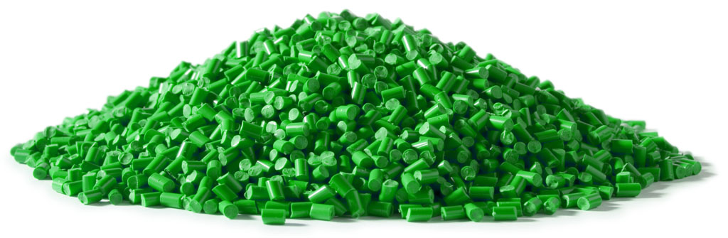
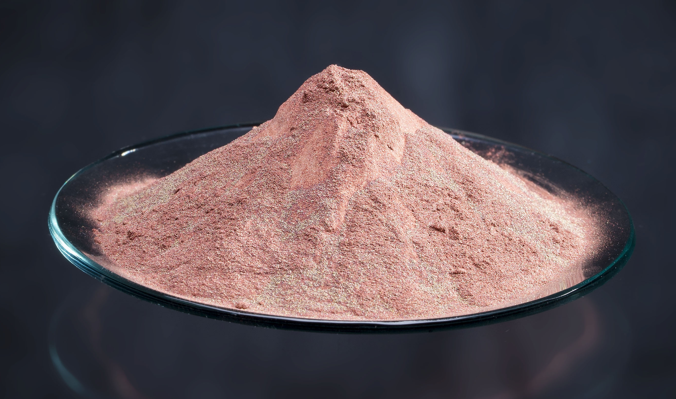
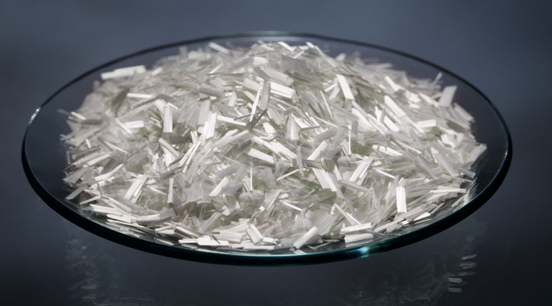
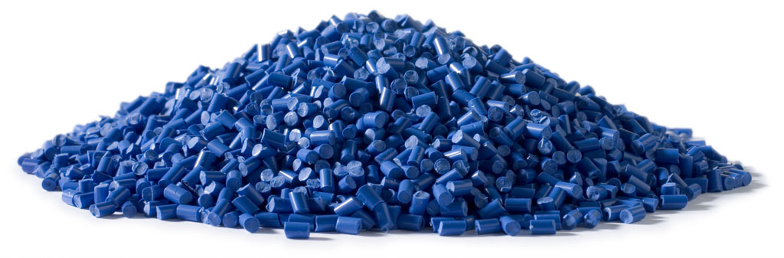
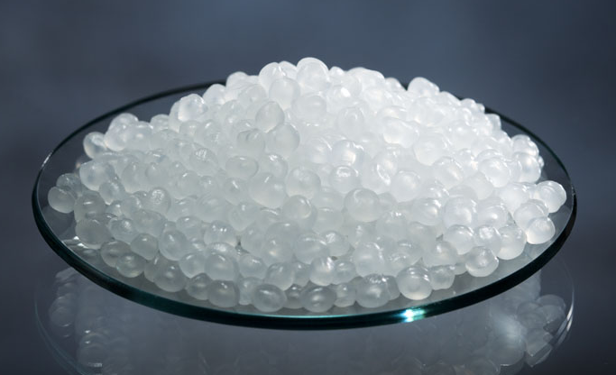
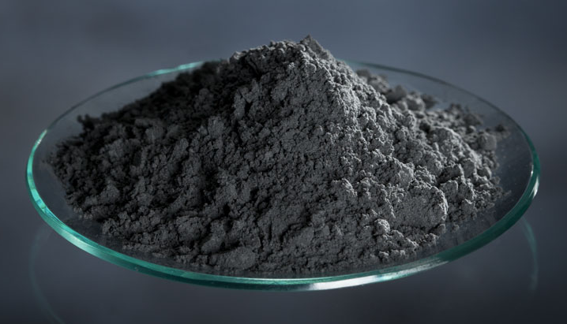
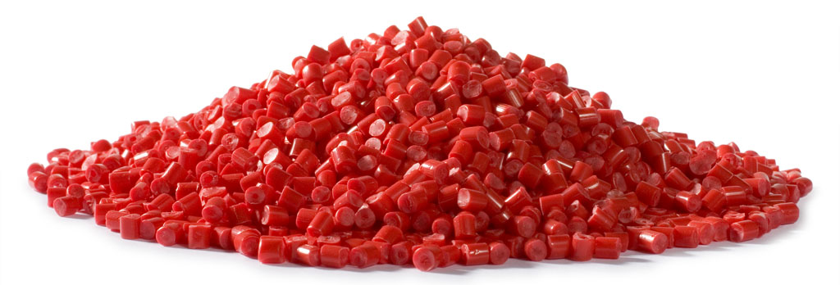
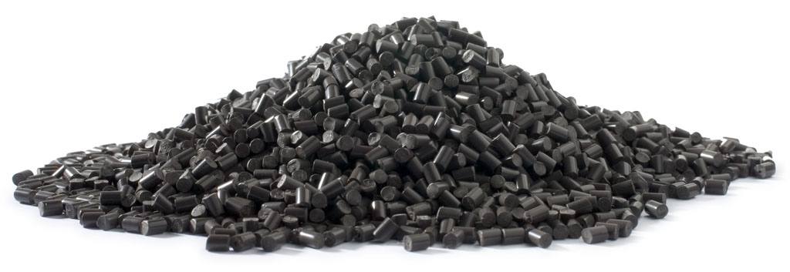
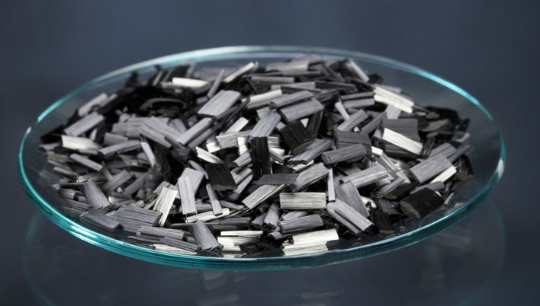
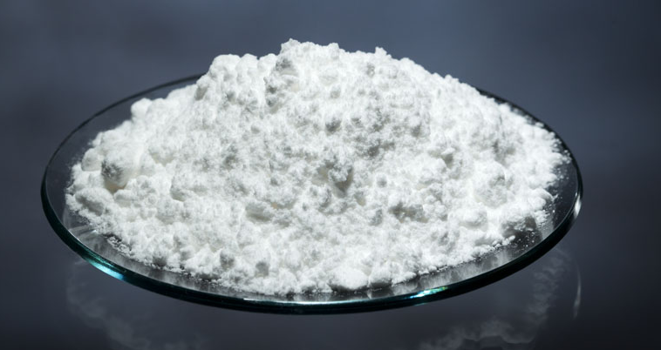
The Dilemma
60 Thermoplastic Resins + 100 Additives = 1000’s of Potential Compounds
?
?
?
?
Which ONE Do I Choose For My Application?
?
?
Notes:
Since there are over 60 thermoplastic resins and hundreds of additives available these can be combined in different ways to produce thousands of thermoplastic compounds. This creates the dilemma for plastic part designers “Which one do I choose for my application?”

Slide 10
Plastic Selection Process
Step 1 -- Use Resin Morphology
Step 2 -- Use Thermal & Cost Requirements
Step 3 -- Fine Tune & Special Features
Notes:
RTP Company helps our customers through this selection process by using a simple yet effective and straight-forward selection process that uses these 3 steps…

Slide 11
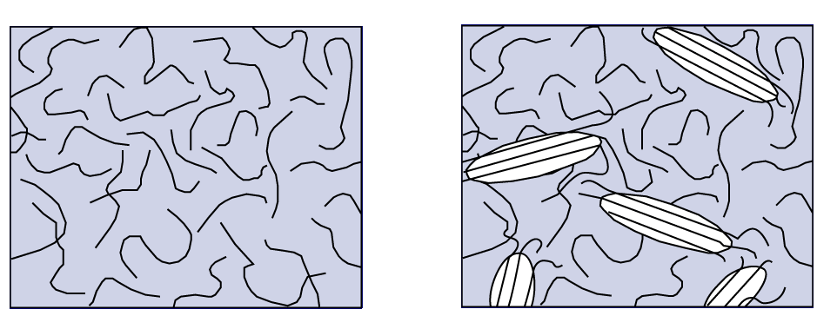
Morphology
The form and structure the molecules of a polymer take upon solidification
Amorphous
Semi-Crystalline
Notes:
11
In step one we look at the morphology of thermoplastic resins which is simply the form and structure that the molecules of the polymer take as the polymer goes from the liquid to solid phase. In thermoplastics you will two types of morphology: either amorphous (random molecular orientation) or semi-crystalline (some molecules orientate into crystals).

Slide 12
Morphology
Amorphous
Semi-Crystalline
Compare
  Molecular Packing (Shrinkage)
  Resistance to Molecular Disentanglement
  (Chemical/Abrasion Resistance)
  Light Refraction (Opacity)
  Melting Characteristics (Flow)
Notes:
12
The 2 morphologies exhibit unique characteristics that result in unique property advantages of each.

Slide 13
Morphology Characteristics
 | Amorphous | Semi-Crystalline
Low Shrinkage | X
Low Warpage | X
Tight Tolerances | X
Transparency | X
Mold Flow Ease |  | X
Chemical Resistance |  | X
Wear Resistance |  | X
Notes:
13
These property advantages include…

Slide 14
Morphology Characteristics
 | Amorphous | Semi-Crystalline
Low Shrinkage | X
Low Warpage | X
Tight Tolerances | X
Transparency | X
Mold Flow Ease |  | X
Chemical Resistance |  | X
Wear Resistance |  | X
Lens?
Fuel Float?
Lamp Housing?
Tool Housing?
Pulley?
Precision Printer Chassis?
Intake Manifold?
Grease Fitting?
Laptop Cover?
Notes:
14
So based on these unique property advantages, which morphology (amorphous or semi-crystalline) would be preferred for each of these applications?

Slide 15
Morphology Of Thermoplastics
Amorphous |  | Semi-Crystalline
Polyetherimide (PEI) Polyethersulfone (PES) Polysulfone (PSU) Amorphous Nylon Polycarbonate (PC) Acrylonitrile Butadiene Styrene (ABS) Styrene Acrylonitrile (SAN) Polystyrene (PS) High Impact Polystyrene (HIPS) Acrylic (PMMA) |  | Polyetheretherketone (PEEK) Polyphenylene Sulfide (PPS) Polyphthalamide (PPA) Polyamide (PA/Nylons) Polyethylene Terephthalate (PET) Polybutylene Terephthalate (PBT) Acetal (POM) Polylactic Acid (PLA) Polypropylene (PP) Polyethylene (HDPE, LDPE, LLDPE)
Notes:
15
So for each application there is typically a preferred morphology. Since about half of the thermoplastics are amorphous and half are semi-crystalline your choices now have been cut in half.

Slide 16
Plastic Selection Process
Step 1 -- Use Resin Morphology
Step 2 -- Use Thermal & Cost Requirements
Step 3 -- Fine Tune & Special Features
Notes:
To further refine our selection process we now go to Step 2 and use thermal performance and cost to narrow the candidates.

Slide 17
Morphology Vs Thermal/Cost
Amorphous |  | Semi-Crystalline
Polyetherimide (PEI) Polyethersulfone (PES) Polysulfone (PSU) Amorphous Nylon Polycarbonate (PC) Acrylonitrile Butadiene Styrene (ABS) Styrene Acrylonitrile (SAN) Polystyrene (PS) High Impact Polystyrene (HIPS) Acrylic (PMMA) |  | Polyetheretherketone (PEEK) Polyphenylene Sulfide (PPS) Polyphthalamide (PPA) Polyamide (PA/Nylons) Polyethylene Terephthalate (PET) Polybutylene Terephthalate (PBT) Acetal (POM) Polylactic Acid (PLA) Polypropylene (PP) Polyethylene (HDPE, LDPE, LLDPE)
Thermal & Cost Increases
Commodity (<$1.50) • Engineered ($1.50-$4.00) • High Performance (>$4.00)
Notes:
17
I have arranged my list of amorphous and semi-crystalline such that as you go form the bottom to the top two properties are increasing. What are they? Thermal performance and cost. Based on this, I can further group each category of plastics into 3 groups: Commodity resins that typically cost less than $1.50/lb , Engineering resins that typically cost $1.50-$4.00/lb , and High Performance resins that cost over $4.00/lb. By using morphology, cost and thermal performance; your resin choice are now quickly reduced to maybe 2-4 options.

Slide 18
Plastic Selection Process
Step 1 -- Use Resin Morphology
Step 2 -- Use Thermal & Cost Requirements
Step 3 -- Fine Tune & Special Features
Notes:
To fine tune our choice and get to that single resin for the application we then take a closer look at the special features of each plastic.

Slide 19
Engineered & Commodity Resins
Amorphous |  | Semi-Crystalline
Amorphous Nylon Polycarbonate (PC) Acrylonitrile Butadiene Styrene (ABS) Styrene Acrylonitrile (SAN) Polystyrene (PS) High Impact Polystyrene (HIPS) Acrylic (PMMA) |  | Polyamide (PA/Nylons) Polyethylene Terephthalate (PET) Polybutylene Terephthalate (PBT) Acetal (POM) Polylactic Acid (PLA) Polypropylene (PP) Polyethylene (HDPE, LDPE, LLDPE)
Commodity (<$1.50) • Engineering ($1.50-$4.00)
Notes:
19
To keep us on time, I am going to limit this exercise to the commodity and engineering resins but it would also work the same with the high performance plastics.

Slide 20
Styrenic Features
Morphology Features -- Low Shrink, Low Warp, Tight Dimensional Tolerances, Transparent (except HIPS & ABS), Poor Chemical & Abrasion
  PS → Good Transparency @ Low Cost, Brittle
  HIPS → Moderate Impact Resistance @ Low Cost
  SAN → Good Transparency, Slightly Better Chemical
  Resistance, Brittle, Low Cost
  ABS → Excellent Impact Resistance & Gloss, Slightly
  Better Chemical Resistance, Low-Moderate Cost
Notes:
Starting with the styrenic plastics (polystyrene, high impact polystyrene, styrene acrylonitrile, and ABS) each have these features…

Slide 21
Acrylic Features
Morphology Features -- Low Shrink, Low Warp, Tight Dimensional Tolerances, Transparent, Poor Chemical & Abrasion
  PMMA → Optical Quality Transparency, Excellent
  UV Stability, Brittle, Low Cost
Notes:
The acrylic or PMMA exhibits these unique features…

Slide 22
Polycarbonate Features
Morphology Features -- Low Shrink, Low Warp, Tight Dimensional Tolerances, Transparent, Poor Chemical & Abrasion
  PC → Optical Quality Transparency, High Impact
  Resistance, Moderate Cost
Notes:
Polycarbonate these….

Slide 23
Olefin Features
Morphology Features -- Excellent Chemical Resistance, Excellent Abrasion Resistance, Good Flow in Thin Mold Sections, Poor Dimensions
  PP → Low Density, Better Thermal Resistance
  Than PE, Living Hinge Capable, Brittle @
  Low Temperatures, Low Cost
  HDPE → Good Low Temp Impact Performance
  (Tg = -77⁰C vs -9⁰C for PP), Low Cost
Notes:
Now on to the semi-crystalline resins, the polyolefins (polypropylene and high density polyethylene) exhibit these unique features…

Slide 24
Polyamide Features
Morphology Features -- Excellent Chemical Resistance, Excellent Abrasion Resistance, Good Flow in Thin Mold Sections (Except Amorphous Nylon), Poor Dimensions
  Nylon 6 → Strong/Stiff (But Humidity Dependent),
  Good Surface Finish Even When
  Reinforced, Moderate Cost
  Nylon 66 → Strong/Stiff (But Humidity
  Dependent), Higher Thermal Than 6,
  Moderate Cost
  Nylon 6/12, → Less Sensitive to Humidity, High Cost
Notes:
The polyamides (nylons) these….

Slide 25
Amorphous Nylon Features
Morphology Features -- Low Shrink, Low Warp, Tight Dimensional Tolerances, Transparent, Poor Abrasion
  Amorphous Nylon → Good Chemical Resistance for
  Amorphous Morphology,
  Moderate-High Cost
Notes:
One exception in the nylon family is that amorphous nylon exhibits amorphous not semi-crystalline performance….

Slide 26
Polyester Features
Morphology Features -- Excellent Chemical Resistance, Excellent Abrasion Resistance, Good Flow in Thin Mold Sections, Poor Dimensions
  PET → Difficult to Mold (Poor Nucleation & Hydrolysis),
  Good Electrical Resistance, Mod. Cost
  PBT → Easy to Mold, Good Electrical Resistance,
  Properties & Dimensions Do Not Fluctuate With
  Humidity (Same For PET), Moderate Cost
  PLA → “Green” Polymer, Poor Impact, Poor Heat
  Resistance, Difficult to Mold (Poor Nucleation &
  Hydrolysis), Low Cost
Notes:
Polyesters (PET, PBT & PLA) exhibit these…

Slide 27
Polyoxymethylene (Acetal) Features
Morphology Features -- Excellent Chemical Resistance, Excellent Abrasion Resistance, Good Flow in Thin Mold Sections, Poor Dimensions
  Acetal → Low Friction & Wear, Excellent Resiliency
  & Fatigue Endurance, Moderate Cost
Notes:
And polyoxymethylene (POM or acetal) exhibit these unique features…..

Slide 28
Putting It All Together
Step 1 -- Use Resin Morphology
Step 2 -- Use Thermal & Cost Requirements
Step 3 -- Fine Tune & Special Features
Test Your Knowledge With Application Examples
Notes:
So let’s put all 3 steps together and test your knowledge as to what resin to use for each of the following applications.

Slide 29
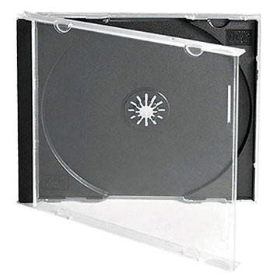
Case Study
CD Jewel Case
  Transparent
  Flat & Dimensionally Stable
  Low Cost
PS
Notes:
CD jewel case. Needs transparency, dimensional stability and low cost. Polystyrene

Slide 30
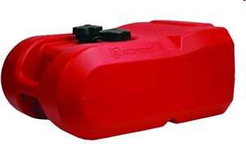
Case Study
Gas Tank
  Good Chemical Resistance
  Good Low Temperature Impact
  Low Cost
HDPE
Notes:
Gas storage tank. Needs chemical resistance, low temperature impact resistance, low cost. High Density Polyethylene (HDPE)

Slide 31
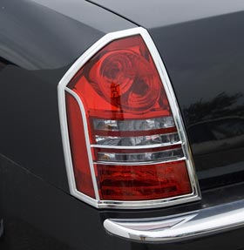
Case Study
Auto Tail Lamp Cover
  Transparent Colors
  Dimensionally Stable
  Excellent UV
  Low Cost
PMMA
Notes:
Automotive tail light cover (lens). Needs transparency, dimensional stability, UV resistance, low cost. Acrylic (PMMA)

Slide 32
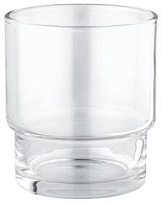
Case Study
Plastic Glass Tumblers
  Transparent
  Reasonable Thermal & Chemical Resistance (Dishwasher Cycles)
  Low Cost
SAN
Notes:
Plastic drink (glass) tumblers. Need transparency, moderate thermal & chemical resistance for dishwasher, and low cost. Styrene Acrylonitrile (SAN)

Slide 33
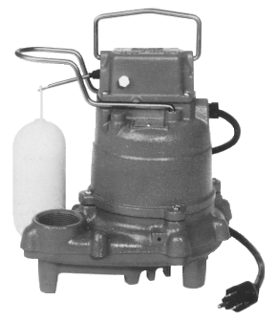
Case Study
Sump Pump Housing
  Chemical Resistance
  Reasonable Thermal Resistance
  Low Cost
PP + GF
Notes:
Sump (waste) pump housing. Needs chemical & moisture resistance, moderate thermal resistance, low cost. Glass fiber reinforced polypropylene (PP)

Slide 34
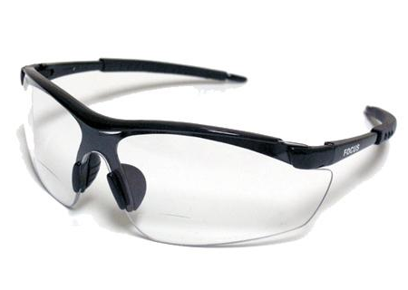
Case Study
Safety Glasses
  Optical Transparency
  High Impact
  Moderate Cost OK
PC
Notes:
Safety glasses. Need optical transparency, high impact resistance, reasonable cost. Polycarbonate (PC)

Slide 35
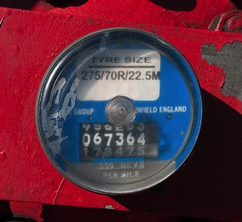
Case Study
Truck Wheel Odometer Lens
  Transparent
  Good Chemical Resistance
  Moderate-High Cost OK
Amorphous Nylon
Notes:
Truck trailer wheel odometer lens. Needs transparency, good chemical resistance, reasonable cost. Amorphous Nylon

Slide 36
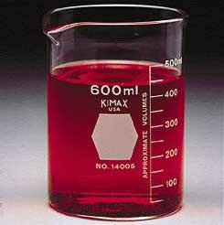
Case Study
Chemical Beakers
  Excellent Chemical Resistance
  Low Cost
  Transparent
?????????
Notes:
Chemical Beakers. Need excellent chemical resistance, low cost, and transparency. Because we have conflicting morphology requirements, there is not an obvious choice and I will show you later how we use compounding to overcome this.

Slide 37
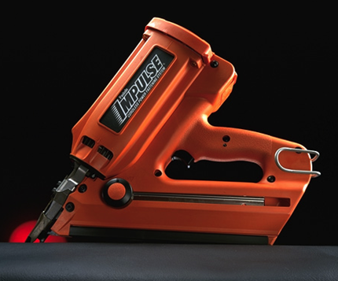
Case Study
Nail Gun Housing
  Good Chemical Resistance
  Excellent Strength, Stiffness & Impact
  Good Surface Finish When Reinforced
  Moderate Cost OK
Nylon 6 + GF
Notes:
Nail gun housing. Need chemical resistance, strength & stiffness, good surface when fiber reinforced, and reasonable cost. Glass fiber reinforced Nylon 6

Slide 38
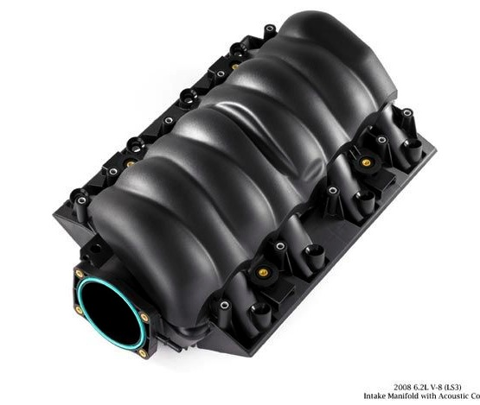
Case Study
Automotive Intake Manifold
  Chemical Resistance
  Excellent Strength, Stiffness & Impact
  Moderate Heat Resistance
  Moderate Cost OK
Nylon 66 + GF
Notes:
Automotive intake manifold. Need chemical resistance, strength & stiffness, good heat resistance, and reasonable cost. Glass fiber reinforced Nylon 66

Slide 39
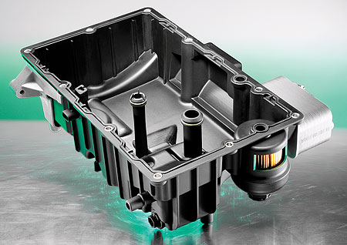
Case Study
Oil Pan
  Chemical Resistance
  Excellent Strength, Stiffness & Impact
  Moderate Heat Resistance
  Moderate Cost OK
  Extremely Tight Dimensions & Flat
?????????
Notes:
Automotive oil pan. Need chemical resistance, strength & stiffness, good heat resistance, extremely tight dimensional stability & flat, reasonable cost. Because we have conflicting morphology requirements, there is not an obvious choice and I will show you later how we use compounding to overcome this.

Slide 40
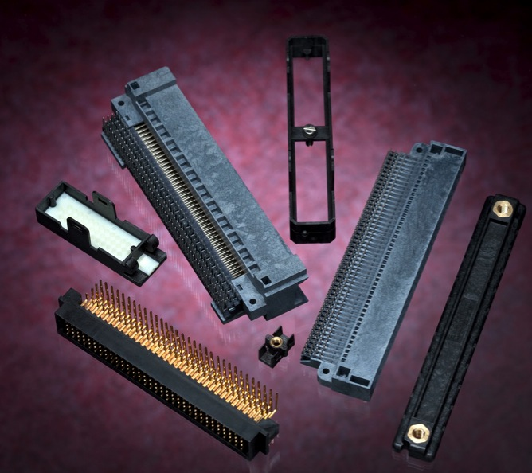
Case Study
Electrical Connectors
  Good Flow in Thin Walls
  Excellent Electrical Properties
  Dimensionally Stable in Humidity
  Moderate Cost OK
PBT (PET) + GF + FR
Notes:
Electrical connectors. Need good flow in thin wall section, excellent electrical properties, dimensionally stable in humidity, reasonable cost. Glass fiber reinforced, flame retardant polyester (PBT or PET)

Slide 41
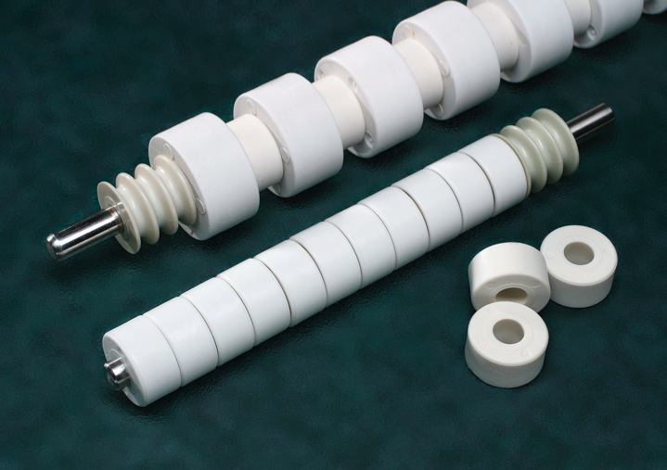
Case Study
Conveyor Rollers
  Good Abrasion Resistance
  Low Wear & Friction
  Moderate Cost OK
Acetal
Notes:
Conveyor rollers. Need good abrasion resistance, low wear rate & low friction, reasonable cost. Acetal (POM)

Slide 42
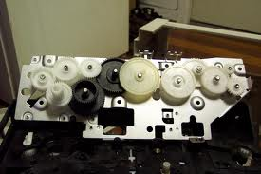
Case Study
Printer Gears
  Extremely Tight Dimensions
  Moderate Cost OK
  Good Abrasion Resistance
  Low Wear & Friction
?????????
Notes:
Printer gears . Need extremely tight dimensions, reasonable cost, good abrasion resistance, low wear rates & low friction. Because we have conflicting morphology requirements, there is not an obvious choice and I will show you later how we use compounding to overcome this.

Slide 43
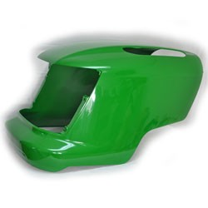
Case Study
Lawn Tractor Hood
  Tight Dimensions & Low Warp
  Moderate Cost OK
  Chemical Resistance
  Good Mold Flow
  High Impact
?????????
Notes:
Lawn tractor hood. Need tight dimensions & flat, reasonable cost, chemical resistance, good flow in mold, and high impact. Because we have conflicting morphology requirements, there is not an obvious choice and I will show you later how we use compounding to overcome this.

Slide 44
Overcoming Morphology Deficiencies
Via Compounding
Notes:
I have shown various application that had conflicting morphology requirements. Let’s show how we can overcome these conflicts by compounding.

Slide 45
Morphology Deficiencies
 | Amorphous | Semi-Crystalline
Low Shrinkage | X | D
Low Warpage | X | D
Tight Tolerances | X | D
Transparency | X | D
Mold Flow Ease | D | X
Chemical Resistance | D | X
Wear Resistance | D | X
Notes:
45
Looking back at this original chart we can see that the amorphous morphology will have deficiencies relating to mold flow, chemical resistance, and wear resistance. The semi-crystalline morphology will have deficiencies relating to dimensional stability and transparency.

Slide 46
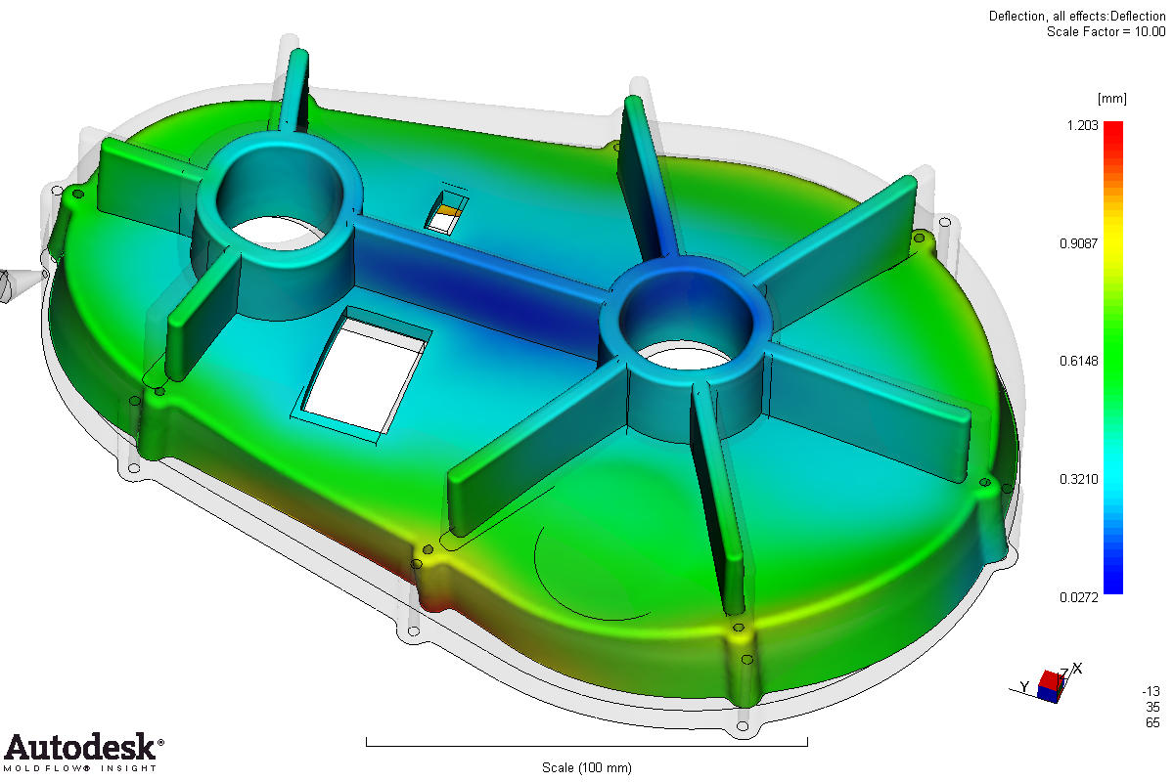
Dimensional Stability
Can We Reduce Shrink Rate & Improve Dimensional Stability of Semi-Crystalline Resins?
Notes:
Let’s start with dimensional stability. Can we reduce the shrink rate of a semi-crystalline resin and make it dimensionally stable?

Slide 47
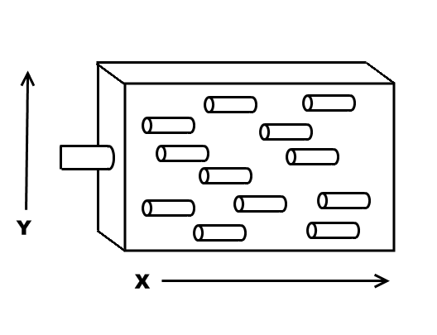
Fiber Reduces Shrink
Shrink Rate X ≠ Shrink Rate Y Warp
Notes:
One way to reduce the shrink rate of a polymer is to add glass fiber. Because glass fibers align themselves in the direction of mold flow, glass fiber will have a tremendous effect to reduce the shrink rate in the direction of mold flow (x) however they do little to reduce it in the transverse to mold flow direction (y). This differential in shrink rate leads to part warpage.

Slide 48
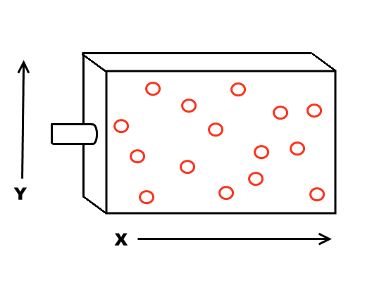
Warp Control
Shrink Rate X = Shrink Rate Y Flat Part
But Low Strength!
Notes:
Instead of adding glass fiber one could add a low aspect filler such as mineral or glass bead. This will reduce shrink rates in both directions and result in a flat and dimensionally stable part. However, low aspect ratio fillers do little to improve strength & stiffness.

Slide 49
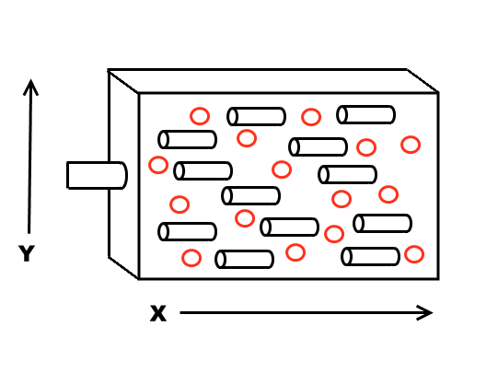
Strength & Warp Control
Common Loading = 15% Glass Fiber &
25% Mineral or Beads
Notes:
So what is commonly done in the compounding world is to add a combination of glass fiber and mineral of glass beads, for instance 15% fiber and 25% mineral or beads, to achieve a dimensionally stable part with strength and stiffness.

Slide 50
Case Study
Oil Pan
  Chemical Resistance
  Excellent Strength, Stiffness & Impact
  Good Heat Resistance
  Moderate Cost OK
  Extremely Tight Dimensions & Flat
Nylon 66 + 15% GF + 25% Mineral
Notes:
Going back to our automotive oil pan that needed chemical resistance, strength & stiffness, with dimensional stability and flat. 15% glass fiber/25% mineral/Nylon 66

Slide 51
Transparency
Can We Make A Semi-Crystalline Resin Transparent?
Notes:
In an amorphous polymer, the molecules are smaller than the wavelength of light and thus the light is able to pass straight through and product is transparent. In a semi-crystalline polymer, the crystals are larger than the wavelength of light so they reflect the light and product is opaque. Can we make a semi-crystalline polymer transparent?

Slide 52
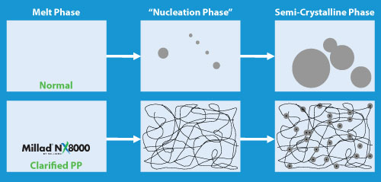
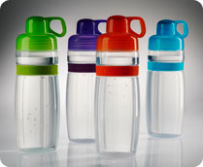
Nucleation/Clarification
Compounding nucleator into PP or PE controls crystal size to less than wavelength of light = Transparency
Courtesy Milliken Chemical
Notes:
One method to do this is to compound a nucleating agent into a semi-crystalline polymer such as polypropylene or polyethylene. The nucleating agent causes numerous crystals to form and there size can be controlled to less that the wavelength of light thus creating a transparent material.

Slide 53
Case Study
Chemical Beakers
  Excellent Chemical Resistance
  Low Cost
  Transparent
PP + Nucleator
Notes:
So for our chemical beaker application requiring excellent chemical resistance, low cost, and transparency. Polypropylene plus nucleating agent.

Slide 54
Chemical Resistance/Mold Flow
Can We Improve Chemical Resistance & Mold Flow of Amorphous Resins?
Notes:
Now looking at the deficiencies of amorphous resins. Can we improve the chemical resistance and ability to flow in the mold of these polymers?

Slide 55
Alloying
Alloy PC with ABS
  RTP 2500 A Series
 | PC | PC/ABS
Tensile Strength, psi | 9000 | 8900
Flexural Mod, E6 psi | 0.34 | 0.40
Izod Impact, ft lb/in | 15 | 13
HDT @ 264 psi,⁰F | 270 | 210
Fuel Resistance | Poor | Poor
Melt Flow, gm/10 min | 10 | 15
Clarity | Transparent | Opaque
Notes:
One compounding technique to do this would be to alloy the amorphous polymer with another polymer. To improve the mold flow of an amorphous polycarbonate (PC) resin one can alloy it with a lower melt temperature polymer such as ABS. This alloy has improved flow however since both polymers are amorphous, the chemical resistance of the alloy is not much improved over the initial PC.

Slide 56
Alloying
Alloy PC With Polyester (PBT or PET)
  RTP 2099 X 63578 B
 | PC | PC/PBT
Tensile Strength, psi | 9000 | 8700
Flexural Mod, E6 psi | 0.34 | 0.35
Izod Impact, ft lb/in | 15 | 15
HDT @ 264 psi, ⁰F | 270 | 250
Fuel Resistance | Poor | Fair
Melt Flow, gm/10 min | 10 | 20
Clarity | Transparent | Opaque
Notes:
By alloying the PC with a lower melting temperature semi-crystalline resin such as PBT or PET one can produce an alloy that has both better mold flow and chemical resistance versus the PC.

Slide 57
Case Study
Lawn Tractor Hood
  Tight Dimensions & Low Warp
  Moderate Cost OK
  Chemical Resistance
  Good Mold Flow
  High Impact
PC/PBT Alloy
Notes:
So for our lawn tractor hood application that requires tight dimensional stability, but good chemical resistance & mold flow, and high impact. A good option would be a PC/PBT alloy.

Slide 58

Case Study
GPS Housing
  Tight Dimensions & Low Warp
  Moderate Cost OK
  Good Mold Flow
  High Impact
PC/ABS or PC/PBT Alloy
  Want Sustainability
PC/PLA Alloy (30% Bio)
  Want More Sustainability
Recycled (PCR) PC/PLA Alloy
(30%Bio + 60% PCR = 90% Sustainable)
Notes:
Learning from the lawn tractor hood, a potential product for this GPS housing might be a PC/ABS or PC/PBT alloy. However, customer is also demanding a sustainable (green) option. RTP developed a PC/PLA alloy but 30% sustainable wasn’t enough. By adding 60 post consumer recycle content, RTP was able to offer a 90% sustainable content compound!

Slide 59
Wear Resistance
Can We Make An Amorphous Resin Wear Resistant?
Notes:
Can we make an amorphous polymer wear resistant?

Slide 60
PTFE Lubricated
Compound PTFE Into PC
  RTP 300 TFE 15
 | PC | PC/15 PTFE | Acetal
Wear Factor | 560 | 130 | 90
Dynamic Coef. of Friction | 0.60 | 0.33 | 0.40
Notes:
One way to accomplish this is to compound a wear resistant additive such as PTFE into the amorphous resin. As shown here, polycarbonate can be made to have similar wear and friction performance as compared to acetal by compounding 15% PTFE into this polymer.

Slide 61
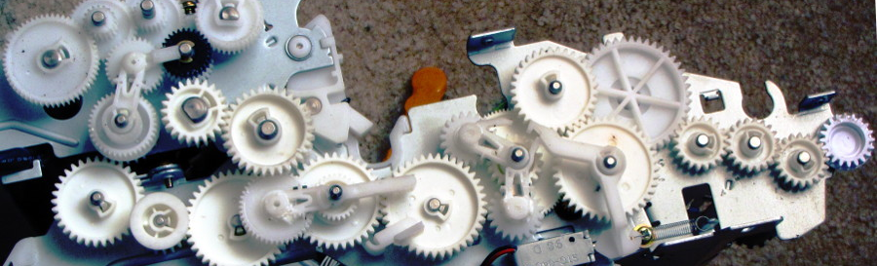
Case Study
Printer Gears
  Extremely Tight Dimensions
  Moderate Cost
  Good Abrasion Resistance
  Low Wear & Friction
PC + PTFE
Notes:
Back to our application for printer gears requiring extremely tight dimension tolerances but with good abrasion resistance and low wear & friction. A good option would be polycarbonate (PC) with a PTFE additive.

Slide 62
Review
Intro To Compounding
The Dilemma
Resin Selection Procedure
  Resin Morphology
  Resin Performance (including cost)
  Unique Resin Features
Application Case Studies
Compounding in Performance
  Overcoming Resin Deficiencies
Notes:
To review: this presentation introduced you to compounding including the objectives and equipment we use to achieve good mixing, it introduced you to the dilemma many face when trying to choose the proper material for an application, it reveled to you the process that RTP Company uses to simplify the resin selection process, tested your knowledge of this process with some actual application case studies, and also showed you how we can use compounding to overcome some of these resin deficiencies for those applications that require both an amorphous and semi-crystalline morphology.

Slide 63
Questions?
Jason Becker
jbecker@rtpcompany.com
(817) 293-5880
Notes:
Any questions?

